Slide 1

pollev.com/mphsessions643
Join the quiz with the link above or scan the QR code with your smartphone

Slide 2
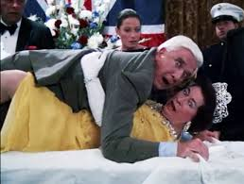
Test Question: Who the lady lying under lieutenant Frank Drebin?

Slide 3
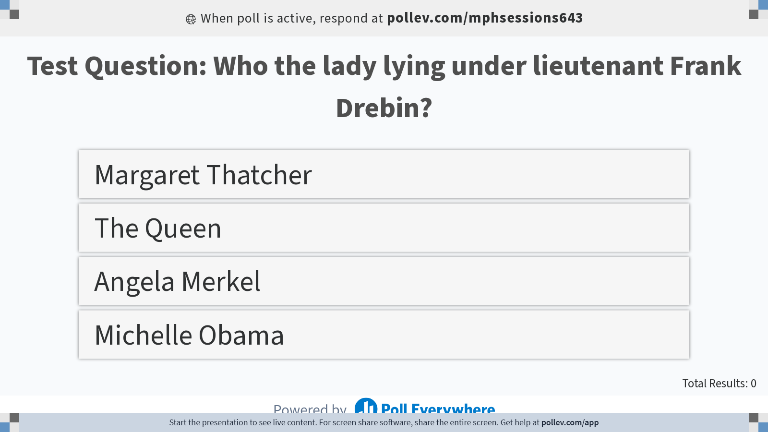
Notes:
Poll Title: Do not modify the notes in this section to avoid tampering with the Poll Everywhere activity. More info at polleverywhere.com/support Test Question: Who the lady lying under lieutenant Frank Drebin? https://www.polleverywhere.com/multiple_choice_polls/qa8mVmPWXjkFBF0VdOEeX?display_state=instructions&activity_state=opened&state=opened&flow=Engagement&onscreen=persist

Slide 4
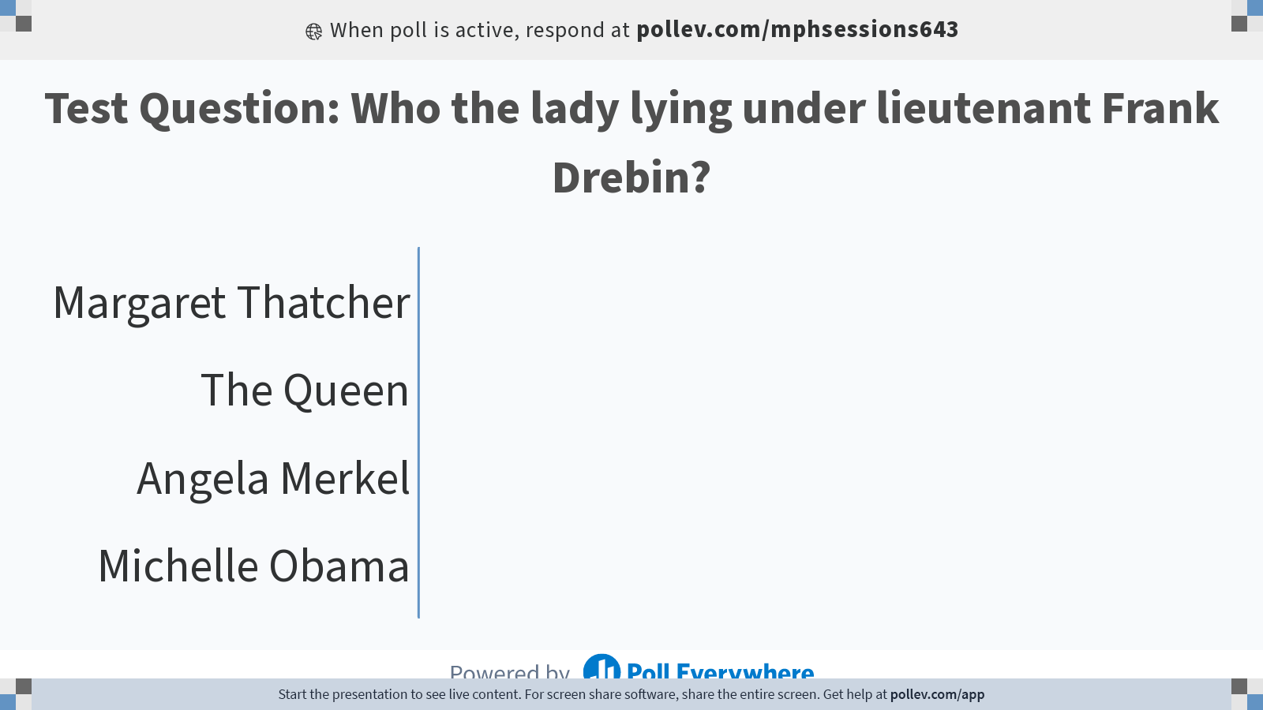
Notes:
Poll Title: Do not modify the notes in this section to avoid tampering with the Poll Everywhere activity. More info at polleverywhere.com/support Test Question: Who the lady lying under lieutenant Frank Drebin? https://www.polleverywhere.com/multiple_choice_polls/qa8mVmPWXjkFBF0VdOEeX?display_state=chart&activity_state=opened&state=opened&flow=Engagement&onscreen=persist

Slide 5
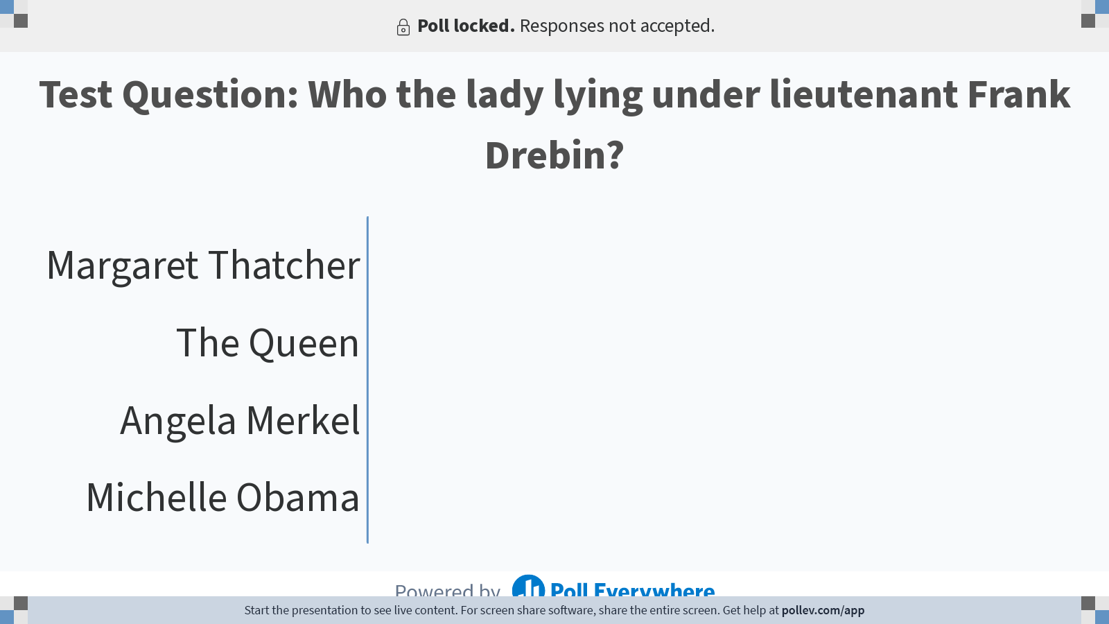
Notes:
Poll Title: Do not modify the notes in this section to avoid tampering with the Poll Everywhere activity. More info at polleverywhere.com/support Test Question: Who the lady lying under lieutenant Frank Drebin? https://www.polleverywhere.com/multiple_choice_polls/qa8mVmPWXjkFBF0VdOEeX?display_state=chart&activity_state=closed&state=closed&flow=Engagement&onscreen=persist

Slide 6
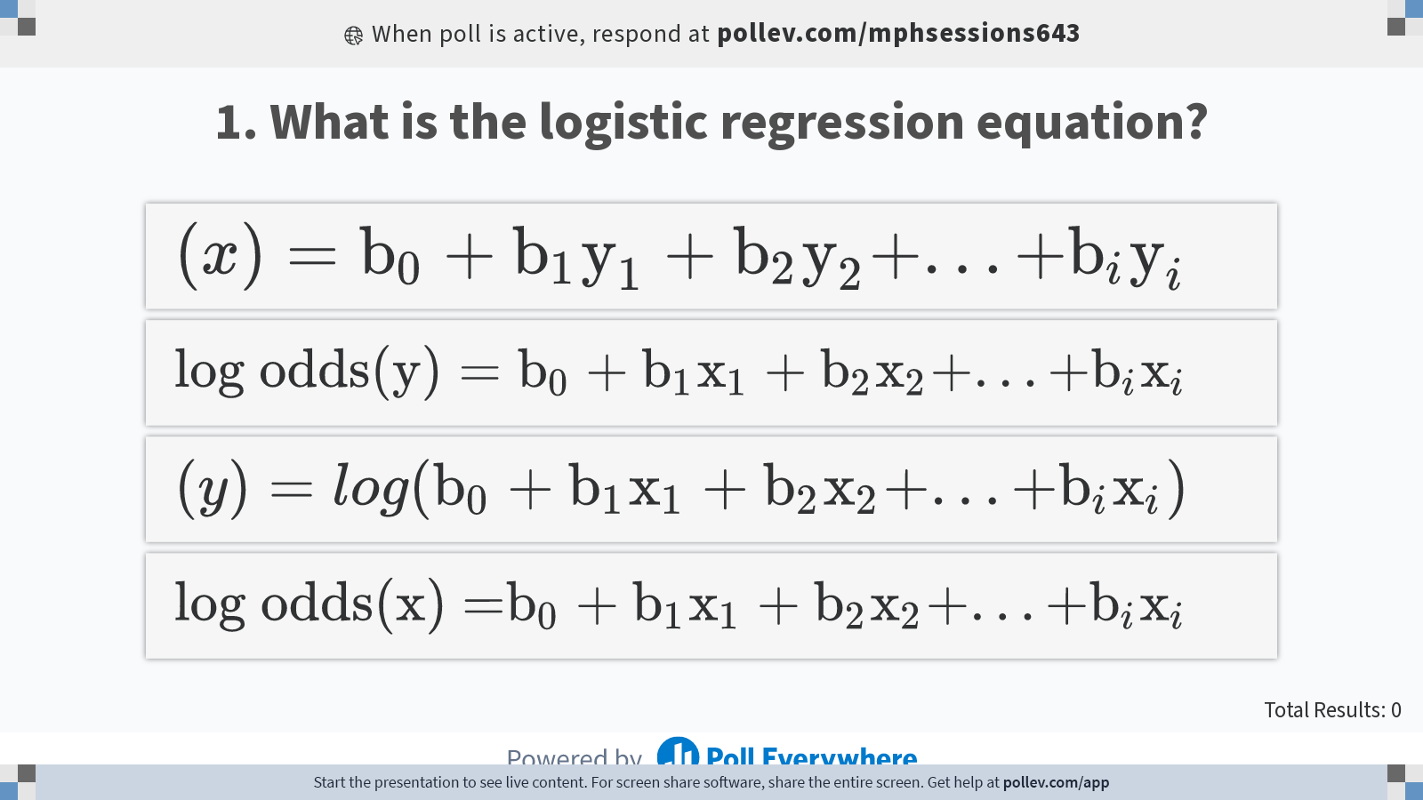
Notes:
Poll Title: Do not modify the notes in this section to avoid tampering with the Poll Everywhere activity. More info at polleverywhere.com/support 1. What is the logistic regression equation? https://www.polleverywhere.com/multiple_choice_polls/F9E1cW4ewWHt4GOEIdv3I?display_state=instructions&activity_state=opened&state=opened&flow=Engagement&onscreen=persist

Slide 7
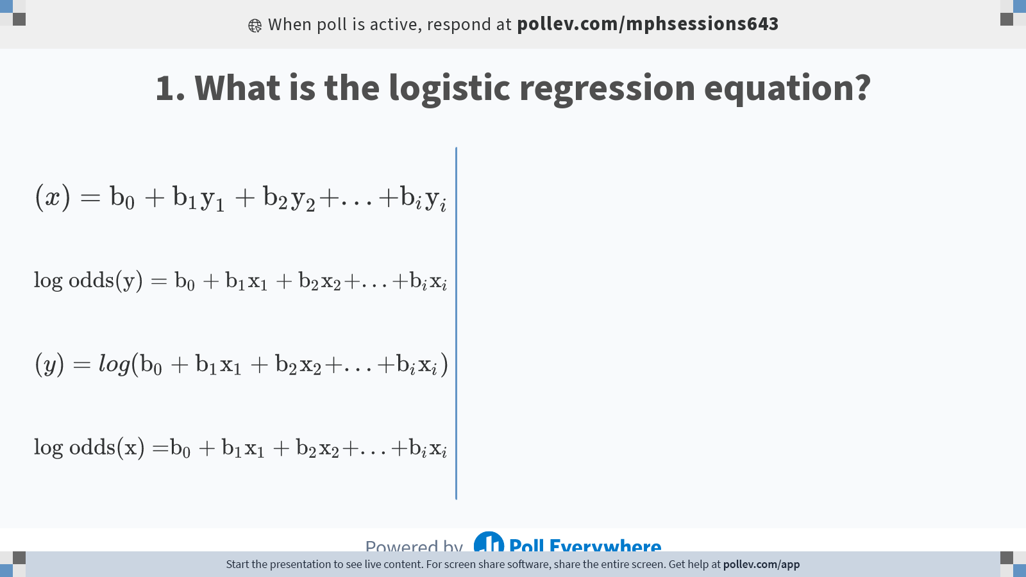
Notes:
Poll Title: Do not modify the notes in this section to avoid tampering with the Poll Everywhere activity. More info at polleverywhere.com/support 1. What is the logistic regression equation? https://www.polleverywhere.com/multiple_choice_polls/F9E1cW4ewWHt4GOEIdv3I?display_state=chart&activity_state=opened&state=opened&flow=Engagement&onscreen=persist

Slide 8
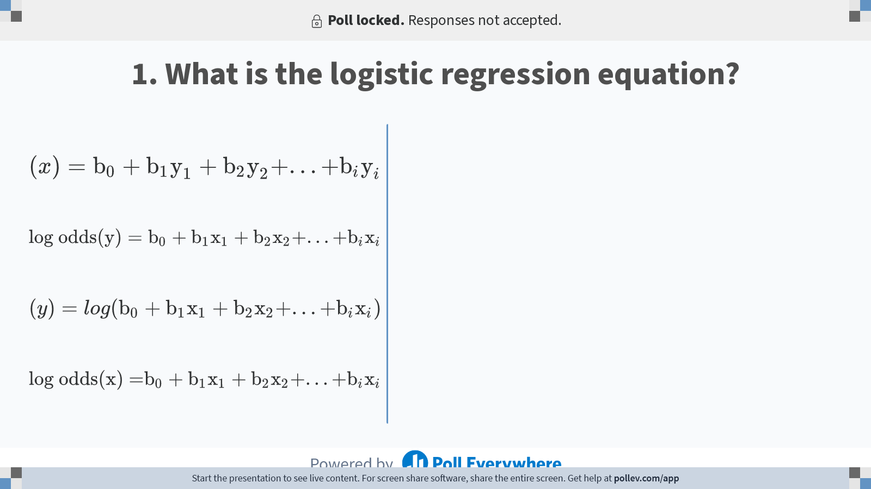
Notes:
Poll Title: Do not modify the notes in this section to avoid tampering with the Poll Everywhere activity. More info at polleverywhere.com/support 1. What is the logistic regression equation? https://www.polleverywhere.com/multiple_choice_polls/F9E1cW4ewWHt4GOEIdv3I?display_state=chart&activity_state=closed&state=closed&flow=Engagement&onscreen=persist

Slide 9
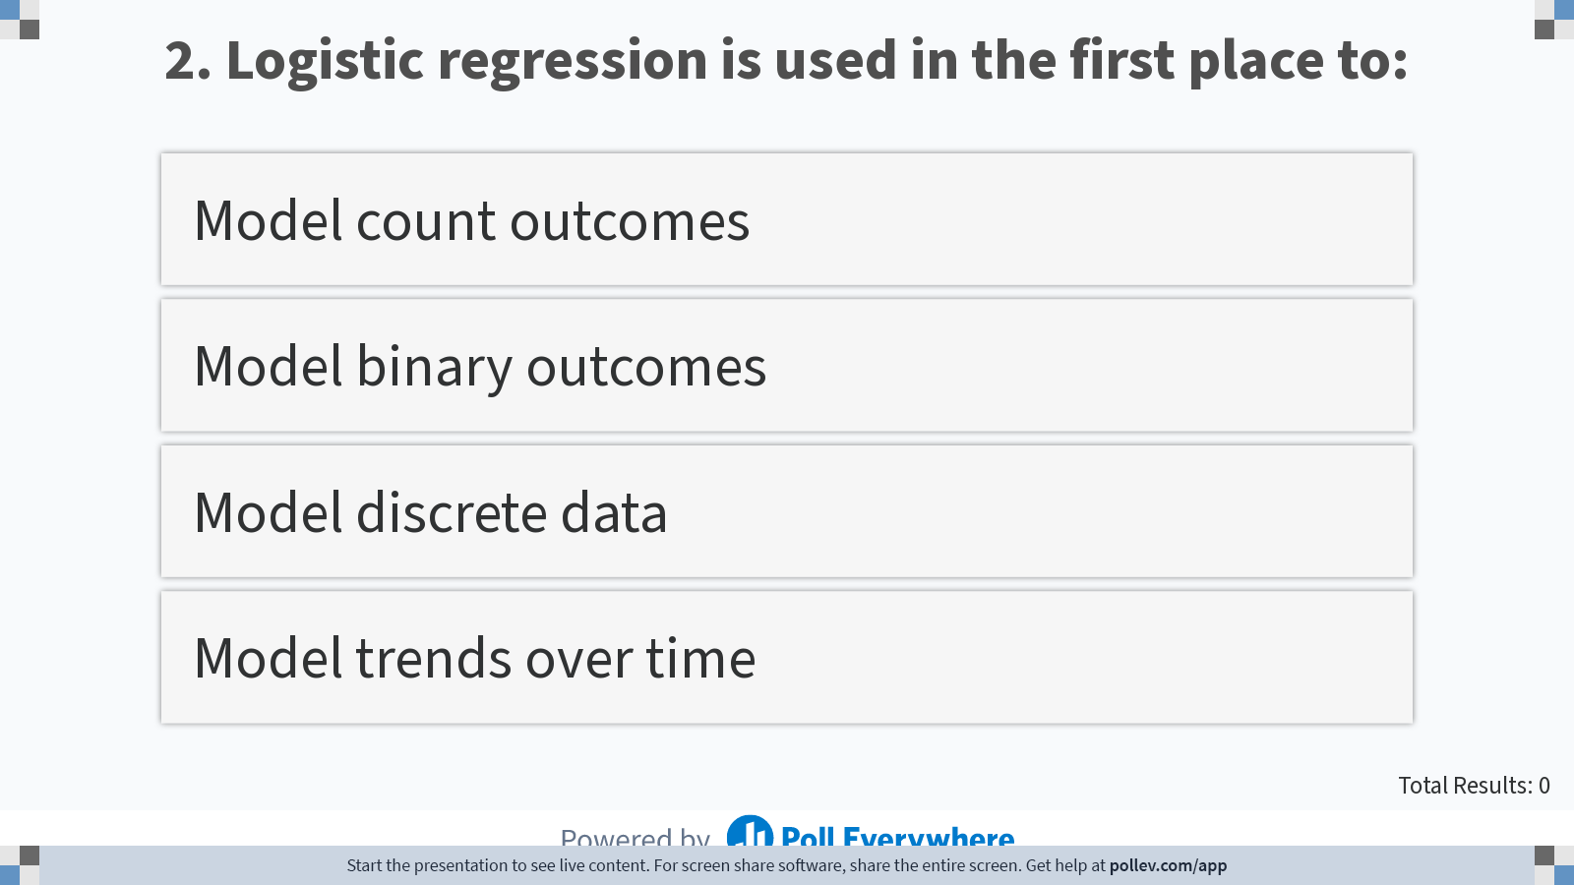
Notes:
Poll Title: Do not modify the notes in this section to avoid tampering with the Poll Everywhere activity. More info at polleverywhere.com/support Logistic regression is used in the first place to: https://www.polleverywhere.com/multiple_choice_polls/B48mXH2gYXEAKiH3bjmSJ?display_state=instructions&activity_state=opened&state=opened&flow=Instructor&onscreen=persist

Slide 10
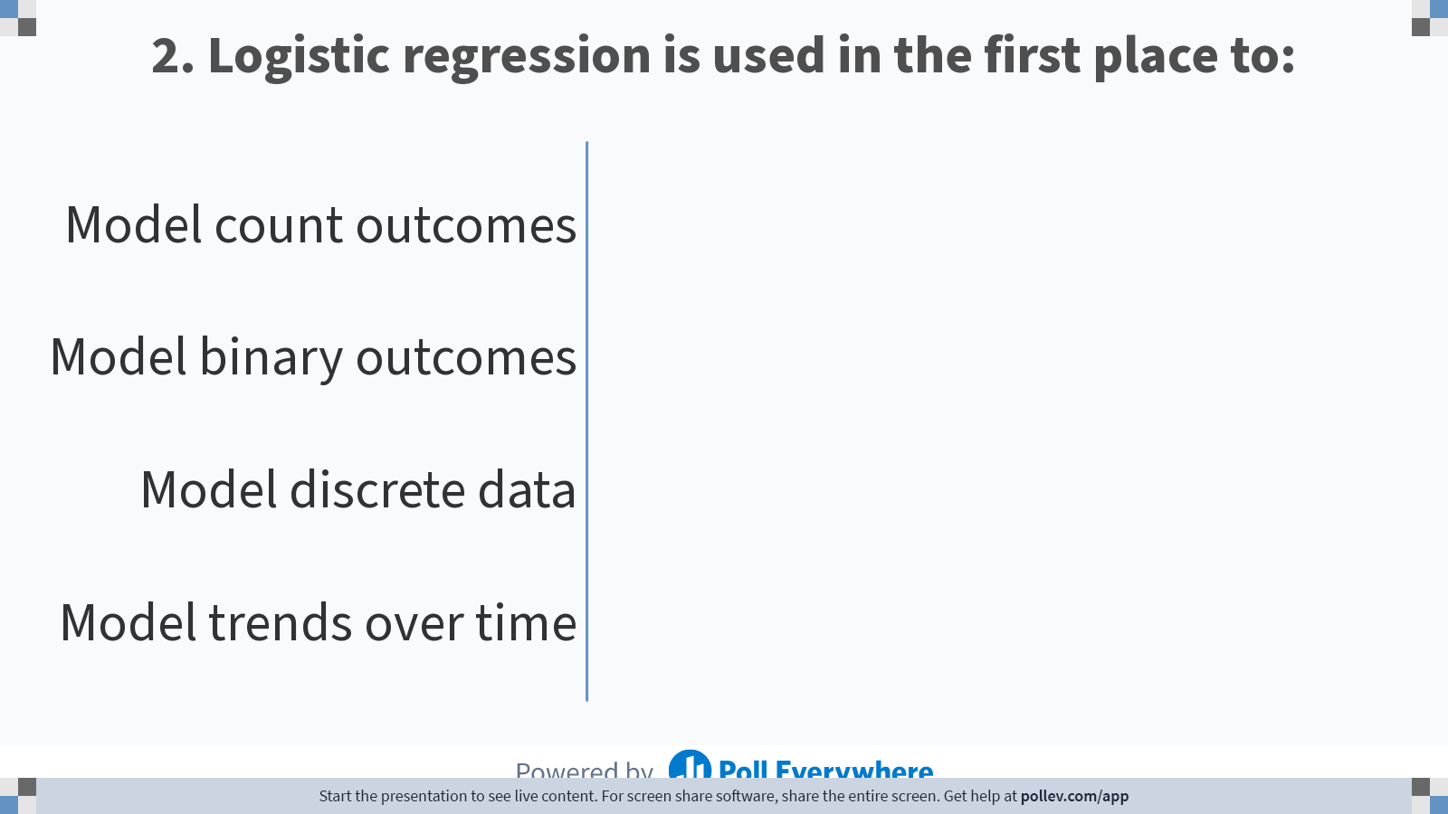
Notes:
Poll Title: Do not modify the notes in this section to avoid tampering with the Poll Everywhere activity. More info at polleverywhere.com/support Logistic regression is used in the first place to: https://www.polleverywhere.com/multiple_choice_polls/B48mXH2gYXEAKiH3bjmSJ?display_state=chart&activity_state=closed&state=closed&flow=Instructor&onscreen=persist

Slide 11
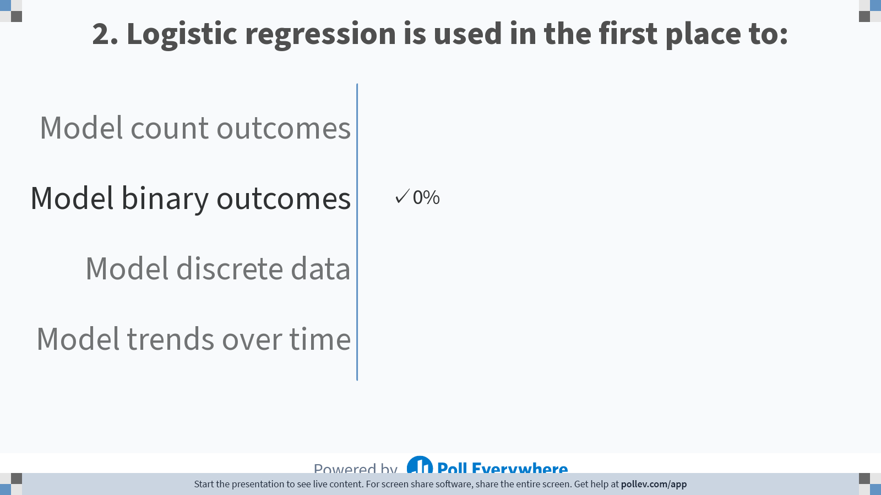
Notes:
Poll Title: Do not modify the notes in this section to avoid tampering with the Poll Everywhere activity. More info at polleverywhere.com/support Logistic regression is used in the first place to: https://www.polleverywhere.com/multiple_choice_polls/B48mXH2gYXEAKiH3bjmSJ?display_state=chart&activity_state=closed&display=correctness&state=closed&flow=Instructor&onscreen=persist

Slide 12
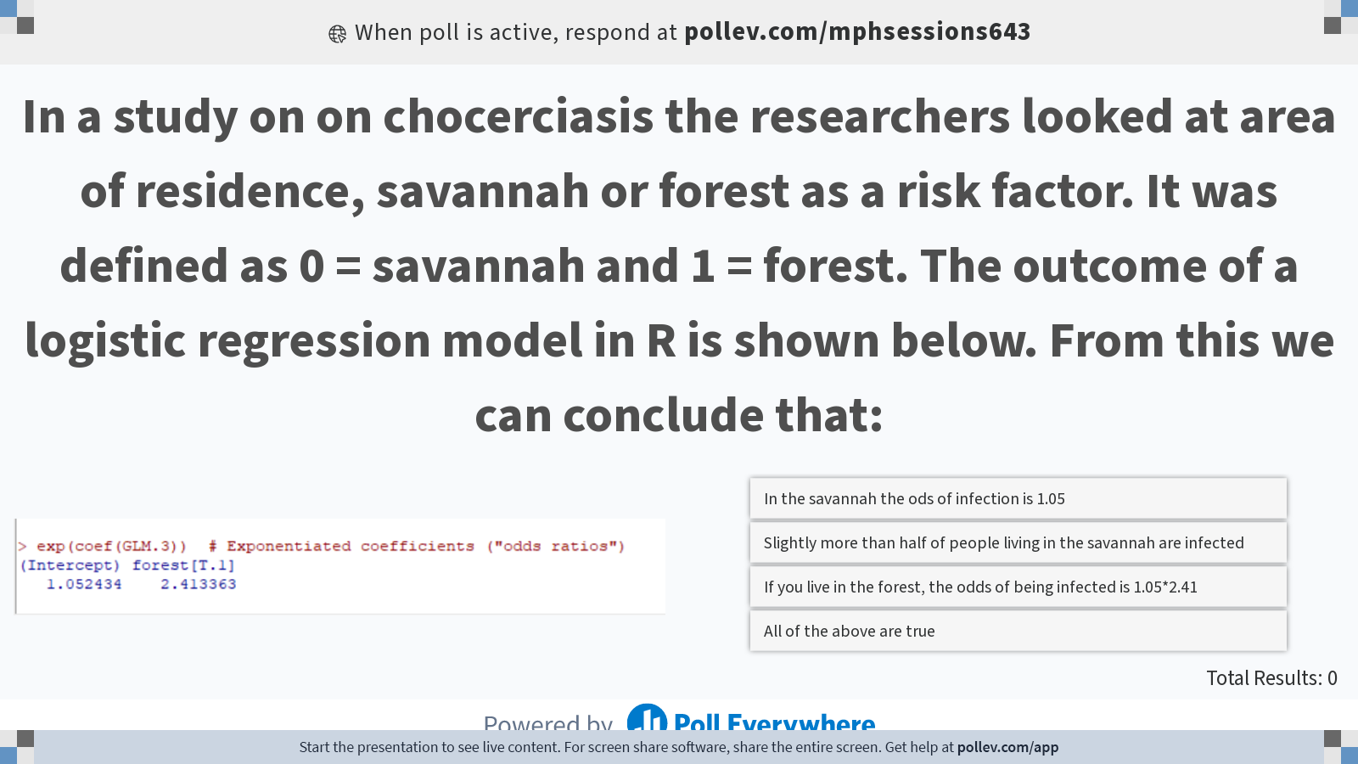
Notes:
Poll Title: Do not modify the notes in this section to avoid tampering with the Poll Everywhere activity. More info at polleverywhere.com/support In a study on on chocerciasis the researchers looked at area of residence, savannah or forest as a risk factor. It was defined as 0 = savannah and 1 = forest. The outcome of a logistic regression model in R is shown below. From this we can conclude that: https://www.polleverywhere.com/multiple_choice_polls/XFtHy5aGTU5yhYZzk9Vvl?display_state=instructions&activity_state=opened&state=opened&flow=Engagement&onscreen=persist

Slide 13
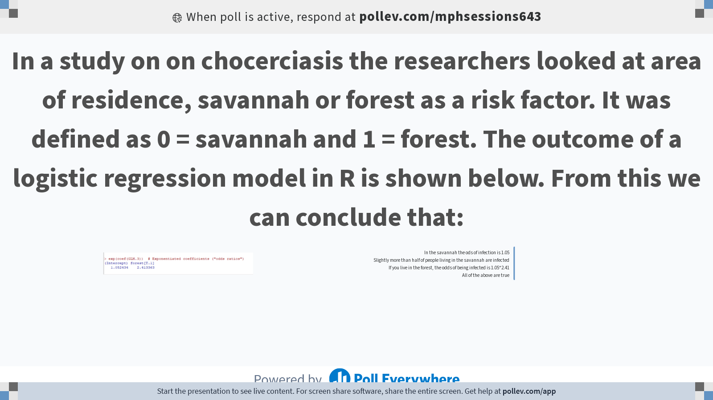
Notes:
Poll Title: Do not modify the notes in this section to avoid tampering with the Poll Everywhere activity. More info at polleverywhere.com/support In a study on on chocerciasis the researchers looked at area of residence, savannah or forest as a risk factor. It was defined as 0 = savannah and 1 = forest. The outcome of a logistic regression model in R is shown below. From this we can conclude that: https://www.polleverywhere.com/multiple_choice_polls/XFtHy5aGTU5yhYZzk9Vvl?display_state=chart&activity_state=opened&state=opened&flow=Engagement&onscreen=persist

Slide 14
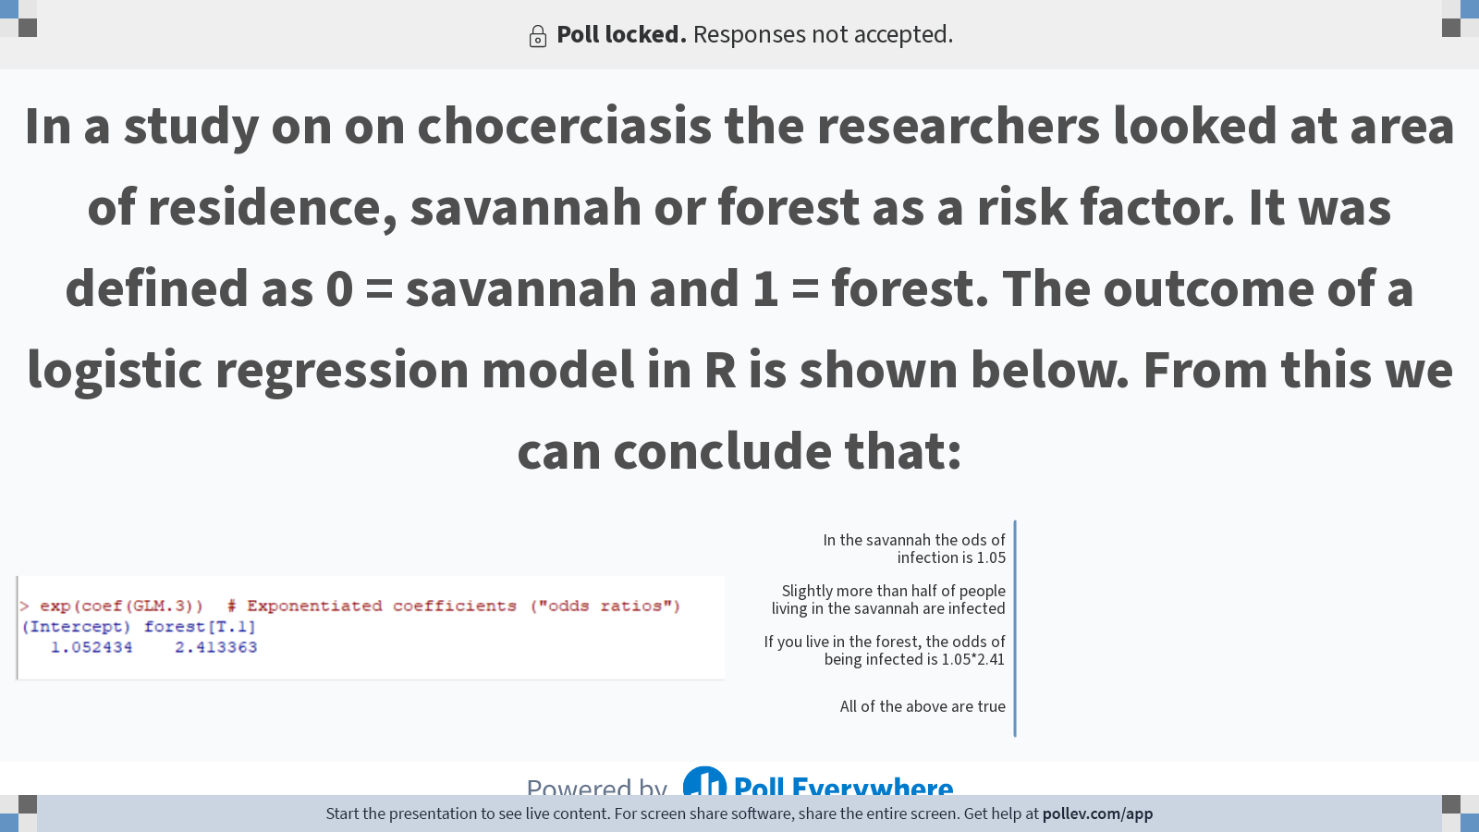
Notes:
Poll Title: Do not modify the notes in this section to avoid tampering with the Poll Everywhere activity. More info at polleverywhere.com/support In a study on on chocerciasis the researchers looked at area of residence, savannah or forest as a risk factor. It was defined as 0 = savannah and 1 = forest. The outcome of a logistic regression model in R is shown below. From this we can conclude that: https://www.polleverywhere.com/multiple_choice_polls/XFtHy5aGTU5yhYZzk9Vvl?display_state=chart&activity_state=closed&state=closed&flow=Engagement&onscreen=persist

Slide 15
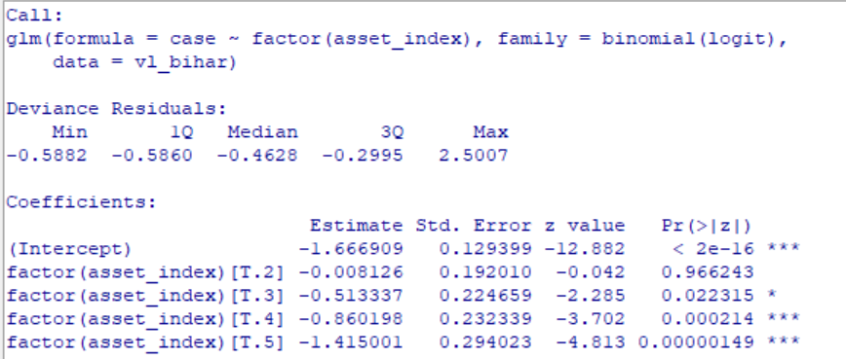
In a study on visceral leishmaniasis in India, the authors assesed a number of risk factors, one of them was the asset-index, an index based on durable consumer items owned by the household as a proxy for socio-economic status. It has been used as a categorical variable. The output below shows results obtained in R Commander. Which of the 5 levels of asset-index carries the highest risk of disease?

Slide 16
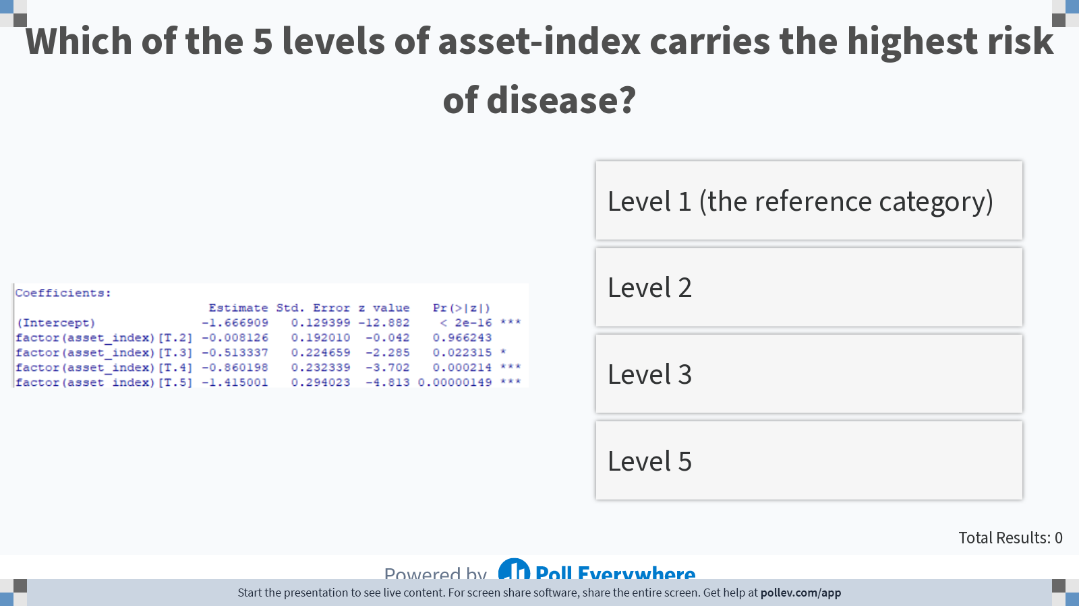
Notes:
Poll Title: Do not modify the notes in this section to avoid tampering with the Poll Everywhere activity. More info at polleverywhere.com/support Which of the 5 levels of asset-index carries the highest risk of disease? https://www.polleverywhere.com/multiple_choice_polls/GTYZjuu1hiwL280WgSf8y?display_state=instructions&activity_state=opened&state=opened&flow=Instructor&onscreen=persist

Slide 17
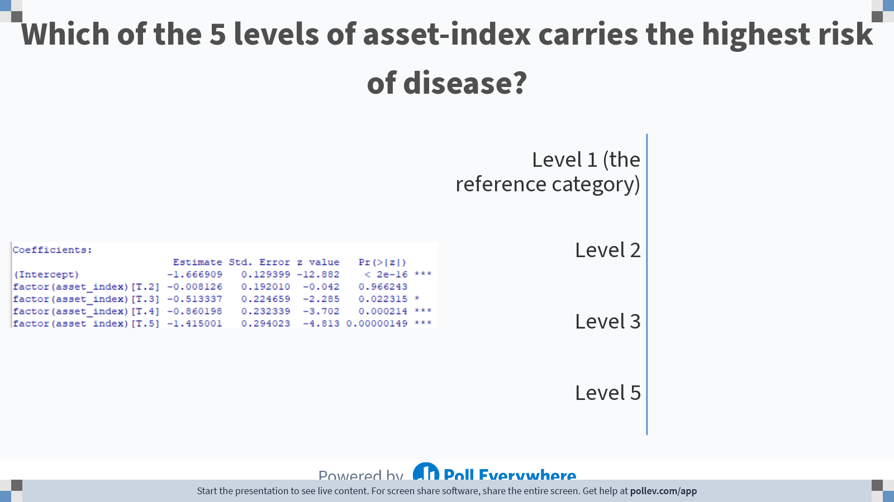
Notes:
Poll Title: Do not modify the notes in this section to avoid tampering with the Poll Everywhere activity. More info at polleverywhere.com/support Which of the 5 levels of asset-index carries the highest risk of disease? https://www.polleverywhere.com/multiple_choice_polls/GTYZjuu1hiwL280WgSf8y?display_state=chart&activity_state=closed&state=closed&flow=Instructor&onscreen=persist

Slide 18
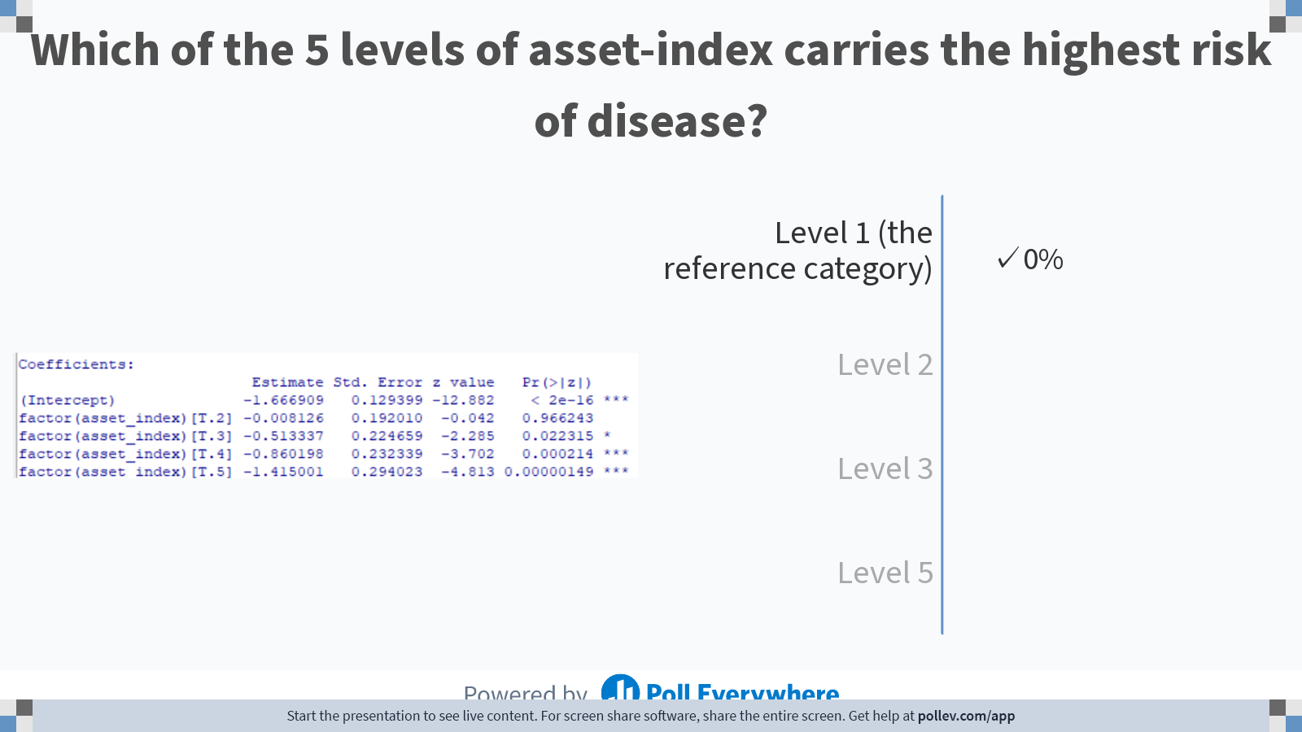
Notes:
Poll Title: Do not modify the notes in this section to avoid tampering with the Poll Everywhere activity. More info at polleverywhere.com/support Which of the 5 levels of asset-index carries the highest risk of disease? https://www.polleverywhere.com/multiple_choice_polls/GTYZjuu1hiwL280WgSf8y?display_state=chart&activity_state=closed&display=correctness&state=closed&flow=Instructor&onscreen=persist

Slide 19
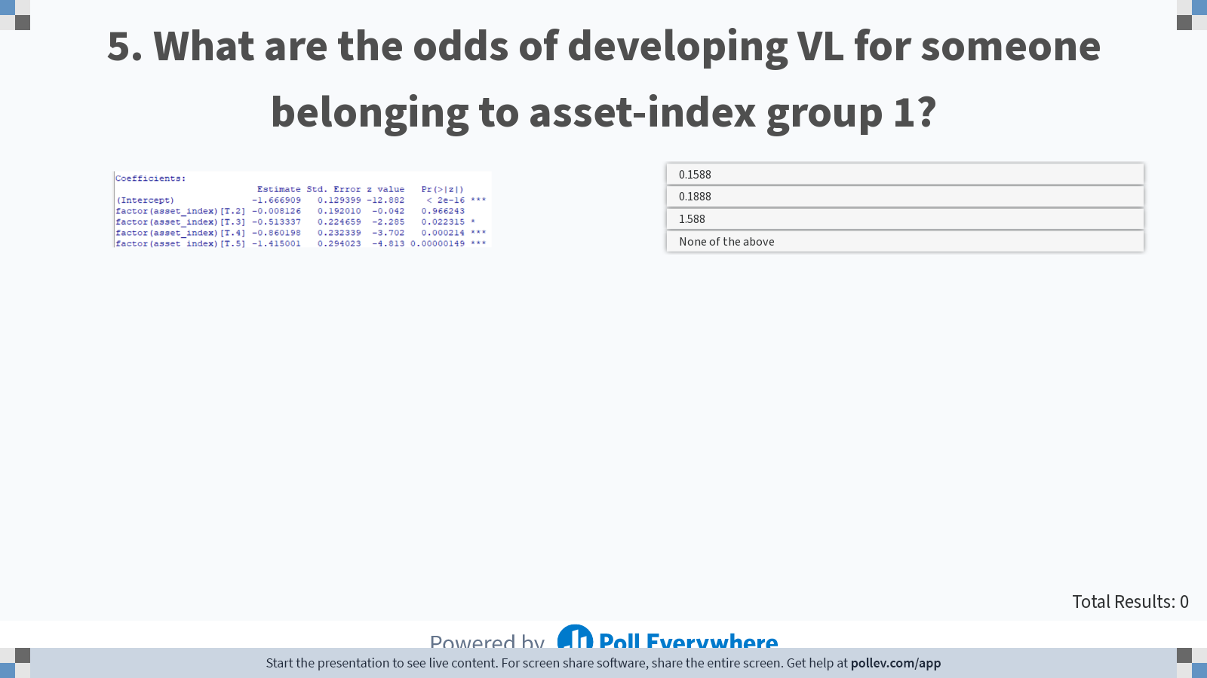
Notes:
Poll Title: Do not modify the notes in this section to avoid tampering with the Poll Everywhere activity. More info at polleverywhere.com/support What are the odds of developing VL for someone belonging to asset-index group 1? https://www.polleverywhere.com/multiple_choice_polls/37SXpIyUZt7WF2iCFsiK5?display_state=instructions&activity_state=opened&state=opened&flow=Instructor&onscreen=persist

Slide 20
Notes:
Poll Title: Do not modify the notes in this section to avoid tampering with the Poll Everywhere activity. More info at polleverywhere.com/support What are the odds of developing VL for someone belonging to asset-index group 1? https://www.polleverywhere.com/multiple_choice_polls/37SXpIyUZt7WF2iCFsiK5?display_state=chart&activity_state=closed&state=closed&flow=Instructor&onscreen=persist

Slide 21
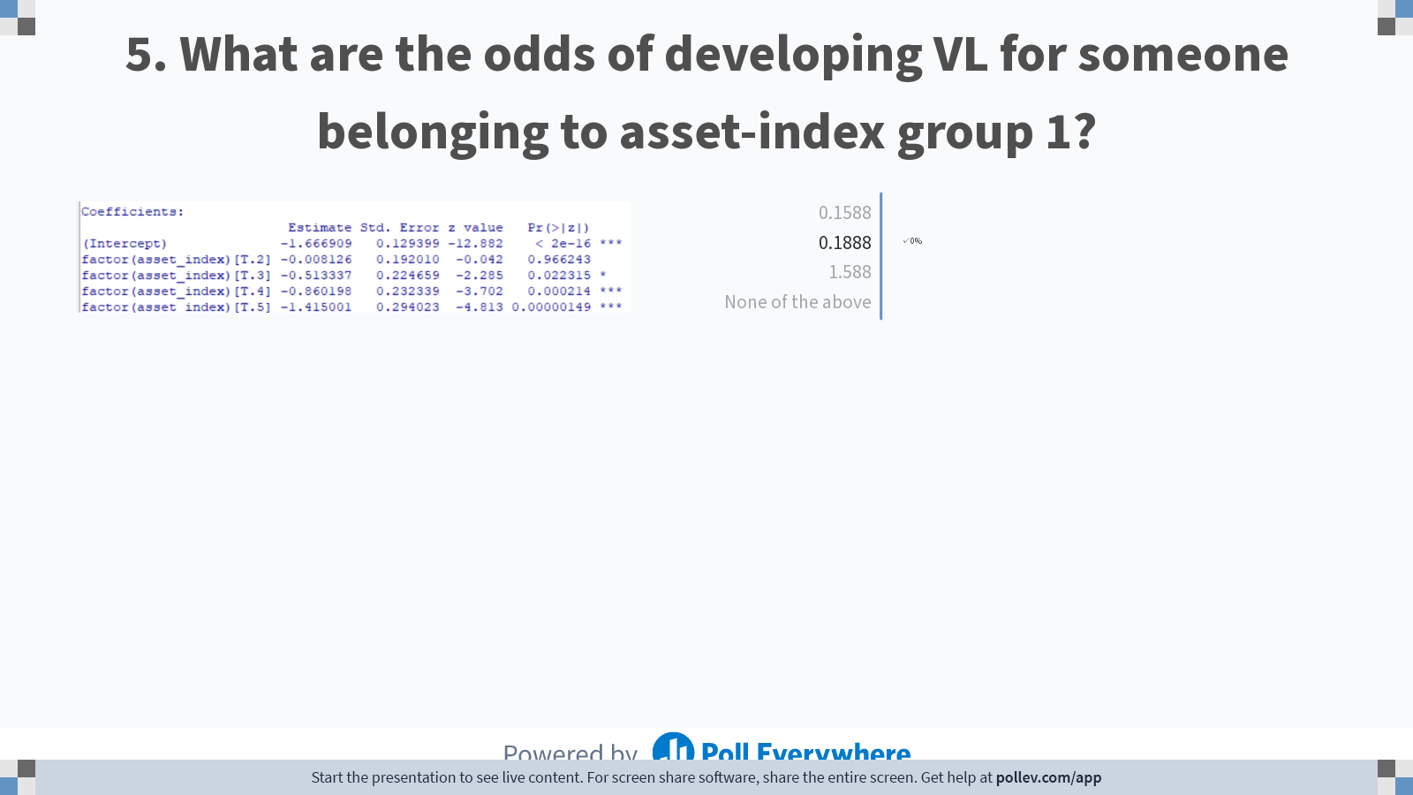
Notes:
Poll Title: Do not modify the notes in this section to avoid tampering with the Poll Everywhere activity. More info at polleverywhere.com/support What are the odds of developing VL for someone belonging to asset-index group 1? https://www.polleverywhere.com/multiple_choice_polls/37SXpIyUZt7WF2iCFsiK5?display_state=chart&activity_state=closed&display=correctness&state=closed&flow=Instructor&onscreen=persist

Slide 22
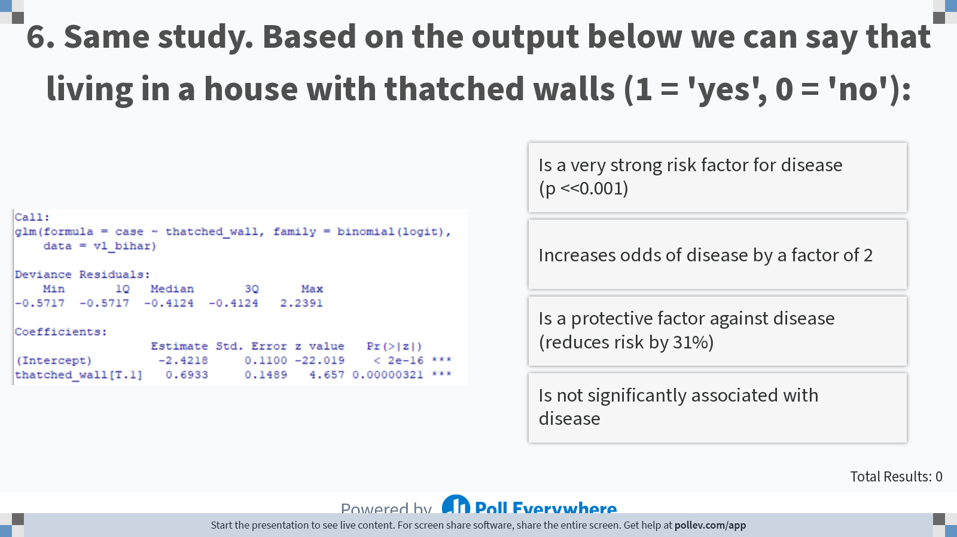
Notes:
Poll Title: Do not modify the notes in this section to avoid tampering with the Poll Everywhere activity. More info at polleverywhere.com/support Same study. Based on the output below we can say that living in a house with thatched walls (1 = 'yes', 0 = 'no'): https://www.polleverywhere.com/multiple_choice_polls/ytHZ4JaQansaDUHFNe1OX?display_state=instructions&activity_state=opened&state=opened&flow=Instructor&onscreen=persist

Slide 23
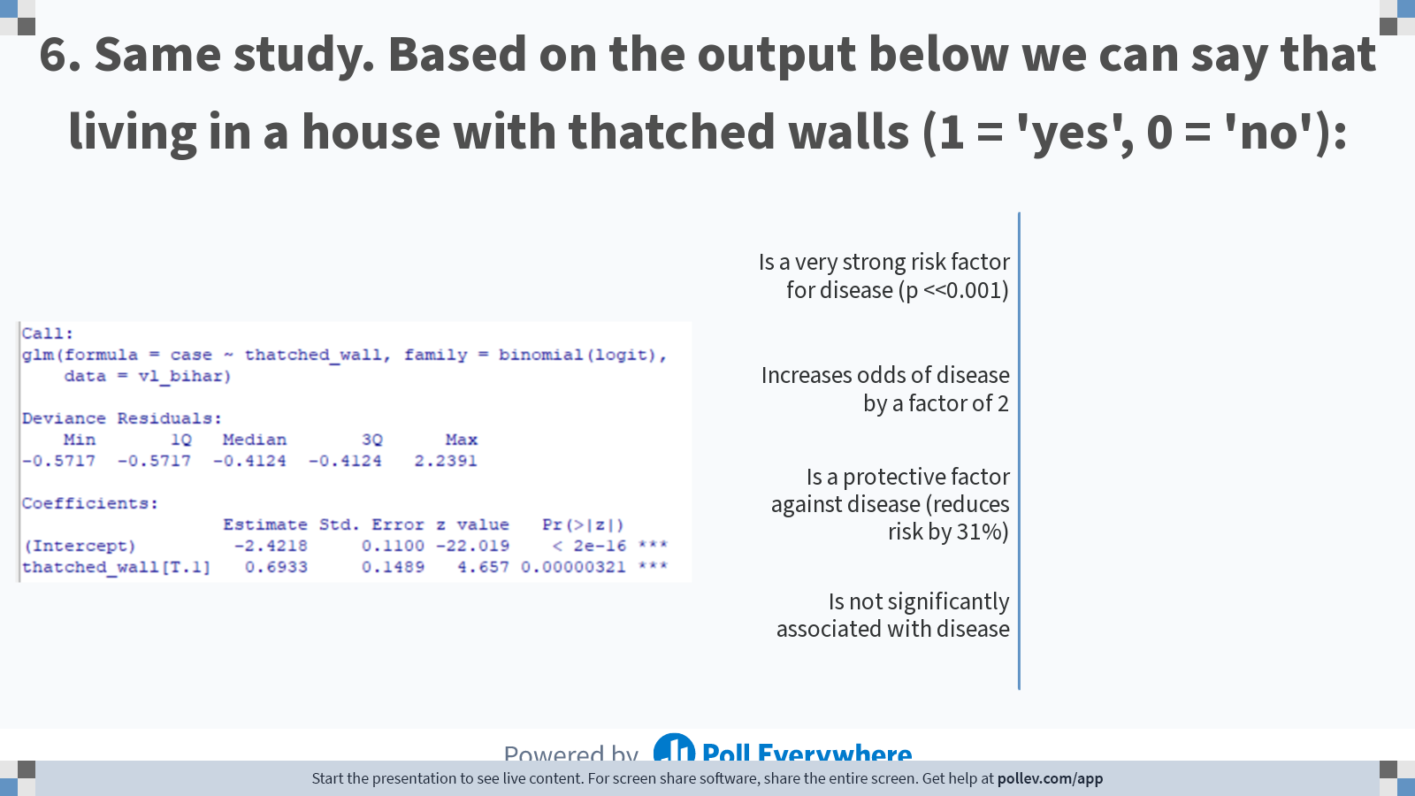
Notes:
Poll Title: Do not modify the notes in this section to avoid tampering with the Poll Everywhere activity. More info at polleverywhere.com/support Same study. Based on the output below we can say that living in a house with thatched walls (1 = 'yes', 0 = 'no'): https://www.polleverywhere.com/multiple_choice_polls/ytHZ4JaQansaDUHFNe1OX?display_state=chart&activity_state=closed&state=closed&flow=Instructor&onscreen=persist

Slide 24
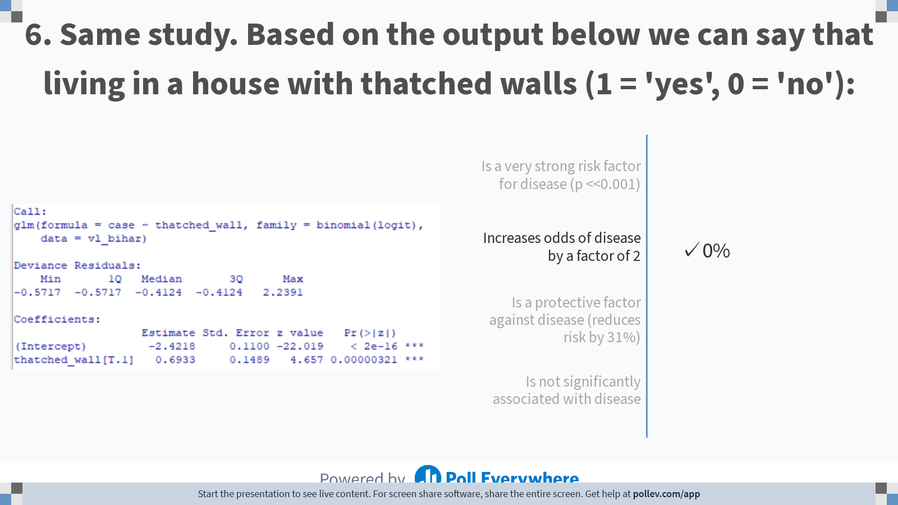
Notes:
Poll Title: Do not modify the notes in this section to avoid tampering with the Poll Everywhere activity. More info at polleverywhere.com/support Same study. Based on the output below we can say that living in a house with thatched walls (1 = 'yes', 0 = 'no'): https://www.polleverywhere.com/multiple_choice_polls/ytHZ4JaQansaDUHFNe1OX?display_state=chart&activity_state=closed&display=correctness&state=closed&flow=Instructor&onscreen=persist

Slide 25
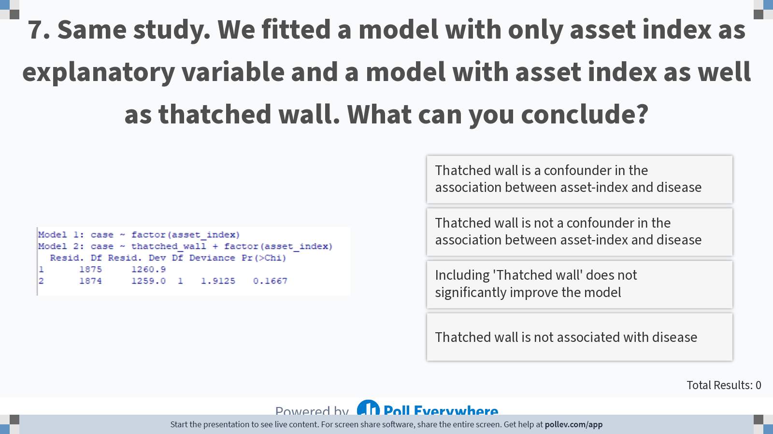
Notes:
Poll Title: Do not modify the notes in this section to avoid tampering with the Poll Everywhere activity. More info at polleverywhere.com/support Same study. We fitted a model with only asset index as explanatory variable and a model with asset index as well as thatched wall. What can you conclude? https://www.polleverywhere.com/multiple_choice_polls/TFPsKKDJ40U45lkRIafJw?display_state=instructions&activity_state=opened&state=opened&flow=Instructor&onscreen=persist

Slide 26
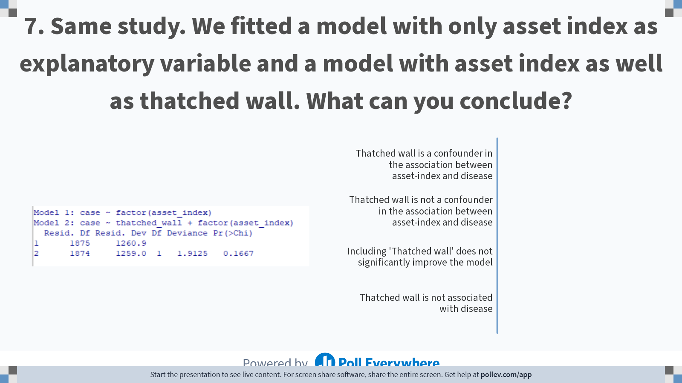
Notes:
Poll Title: Do not modify the notes in this section to avoid tampering with the Poll Everywhere activity. More info at polleverywhere.com/support Same study. We fitted a model with only asset index as explanatory variable and a model with asset index as well as thatched wall. What can you conclude? https://www.polleverywhere.com/multiple_choice_polls/TFPsKKDJ40U45lkRIafJw?display_state=chart&activity_state=closed&state=closed&flow=Instructor&onscreen=persist

Slide 27
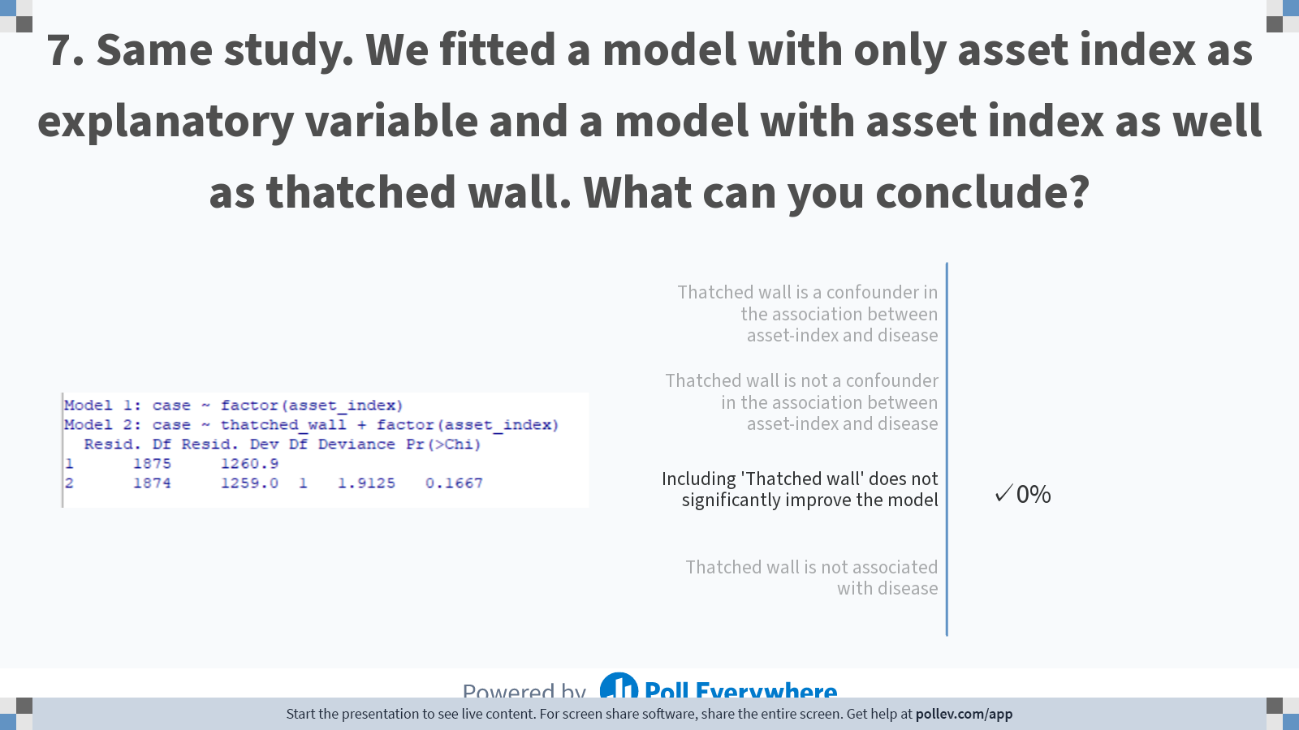
Notes:
Poll Title: Do not modify the notes in this section to avoid tampering with the Poll Everywhere activity. More info at polleverywhere.com/support Same study. We fitted a model with only asset index as explanatory variable and a model with asset index as well as thatched wall. What can you conclude? https://www.polleverywhere.com/multiple_choice_polls/TFPsKKDJ40U45lkRIafJw?display_state=chart&activity_state=closed&display=correctness&state=closed&flow=Instructor&onscreen=persist

Slide 28
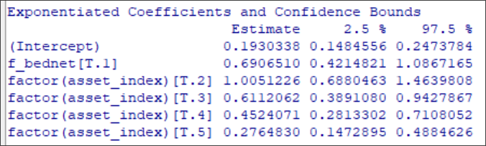
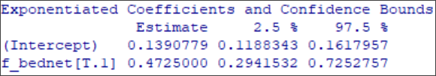
Below are outputs of two models, exponentiated coefficients, one with only bednet as predictor, the other with bednet as well as asset-index. What can we conclude?

Slide 29
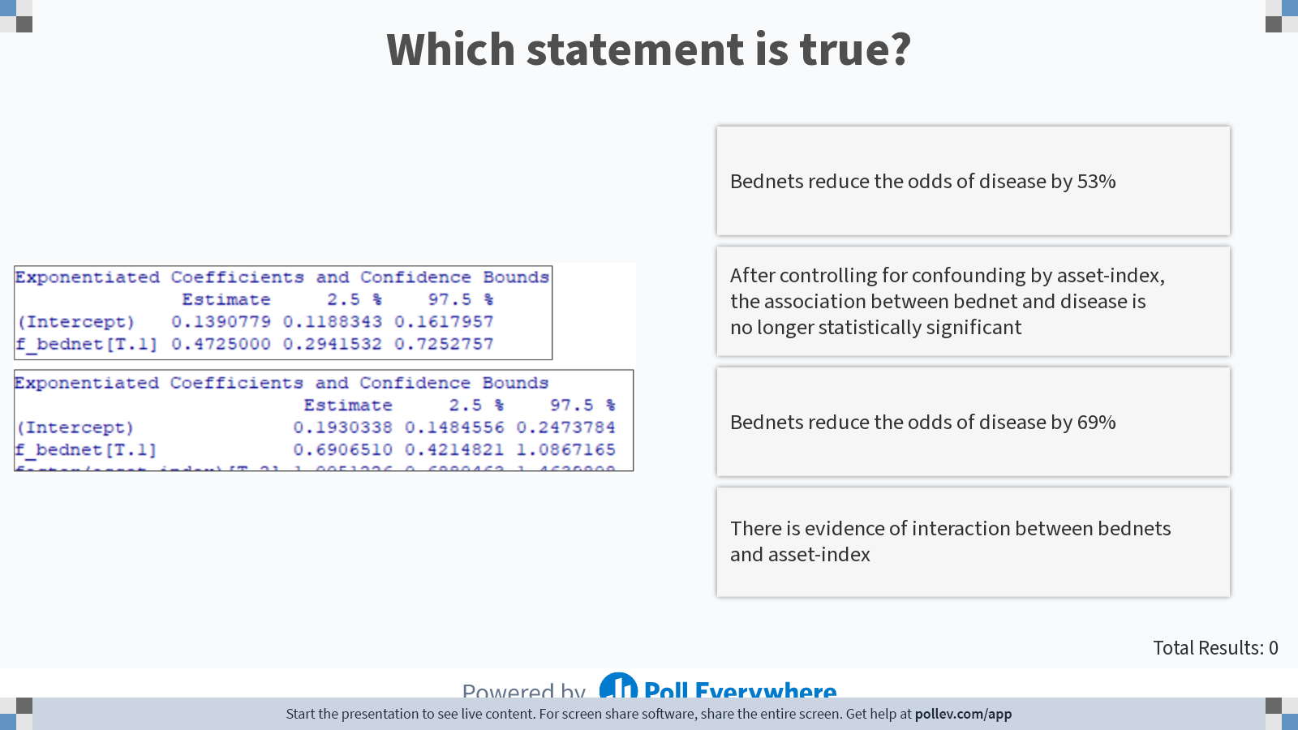
Notes:
Poll Title: Do not modify the notes in this section to avoid tampering with the Poll Everywhere activity. More info at polleverywhere.com/support Which statement is true? https://www.polleverywhere.com/multiple_choice_polls/3QZ1QsgPWq5MDeIswg6MR?display_state=instructions&activity_state=opened&state=opened&flow=Instructor&onscreen=persist

Slide 30
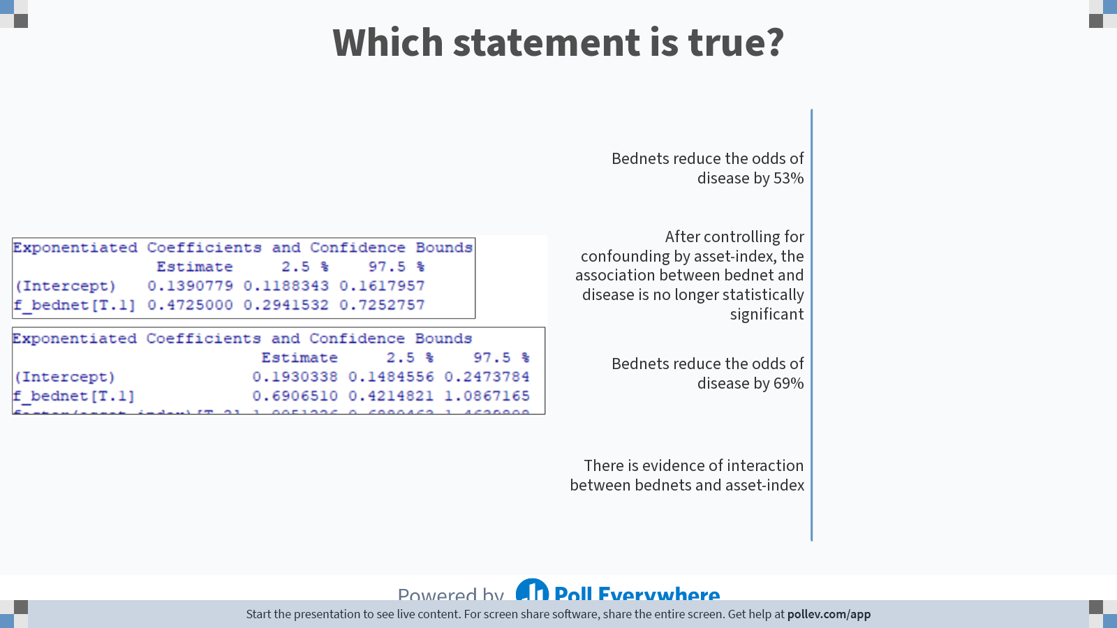
Notes:
Poll Title: Do not modify the notes in this section to avoid tampering with the Poll Everywhere activity. More info at polleverywhere.com/support Which statement is true? https://www.polleverywhere.com/multiple_choice_polls/3QZ1QsgPWq5MDeIswg6MR?display_state=chart&activity_state=closed&state=closed&flow=Instructor&onscreen=persist

Slide 31
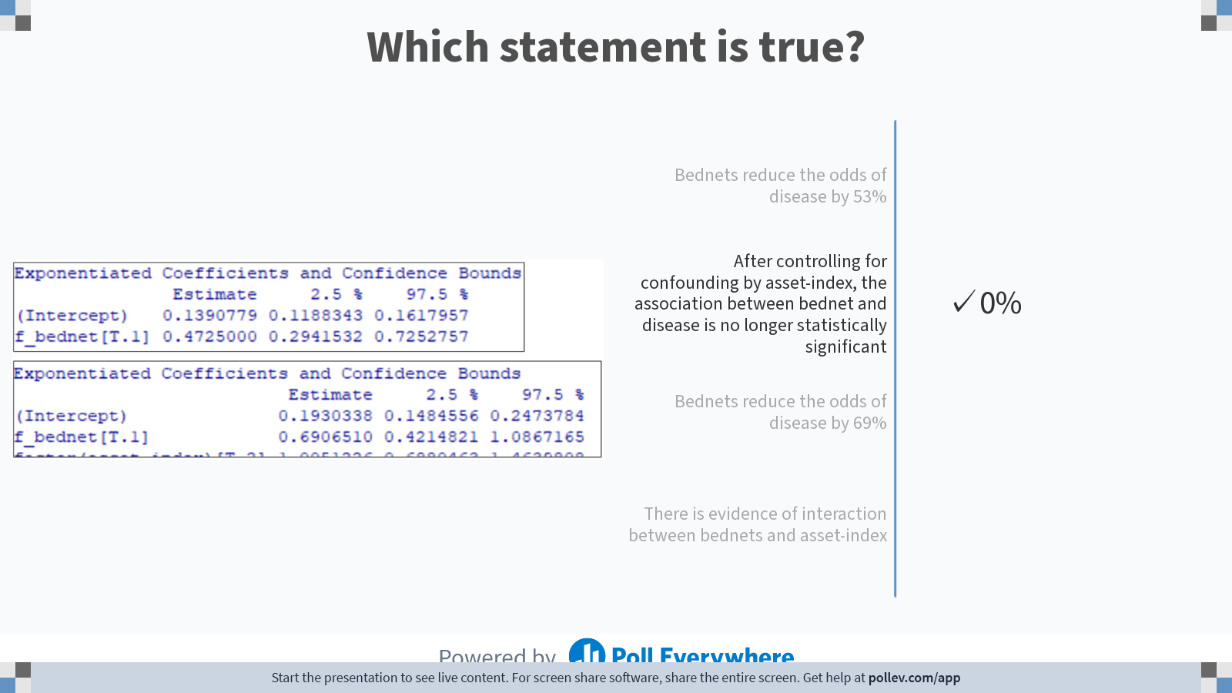
Notes:
Poll Title: Do not modify the notes in this section to avoid tampering with the Poll Everywhere activity. More info at polleverywhere.com/support Which statement is true? https://www.polleverywhere.com/multiple_choice_polls/3QZ1QsgPWq5MDeIswg6MR?display_state=chart&activity_state=closed&display=correctness&state=closed&flow=Instructor&onscreen=persist

Slide 32
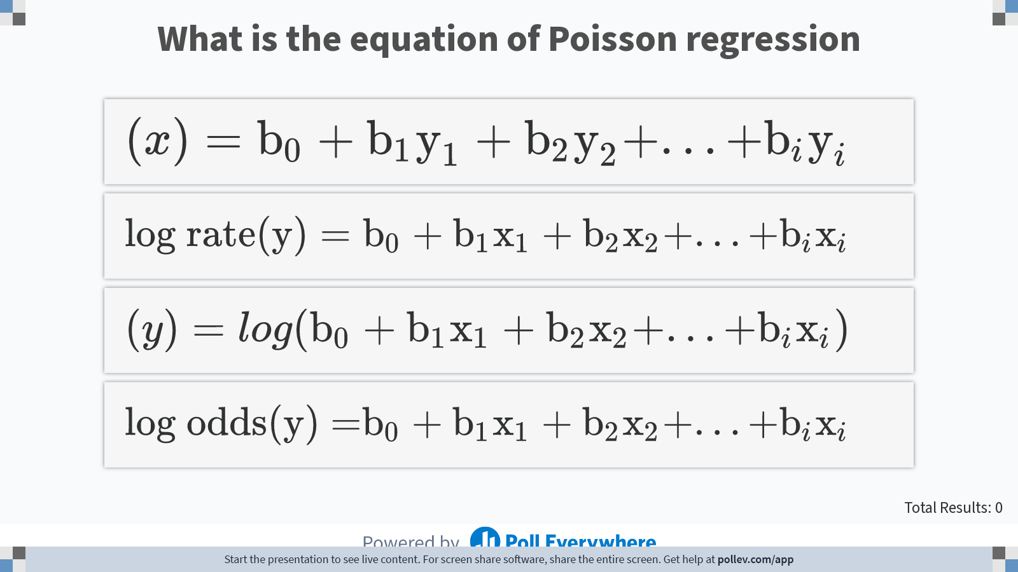
Notes:
Poll Title: Do not modify the notes in this section to avoid tampering with the Poll Everywhere activity. More info at polleverywhere.com/support What is the equation of Poisson regression https://www.polleverywhere.com/multiple_choice_polls/LireSuaDCX8cMy7FoOuOp?display_state=instructions&activity_state=opened&state=opened&flow=Instructor&onscreen=persist

Slide 33
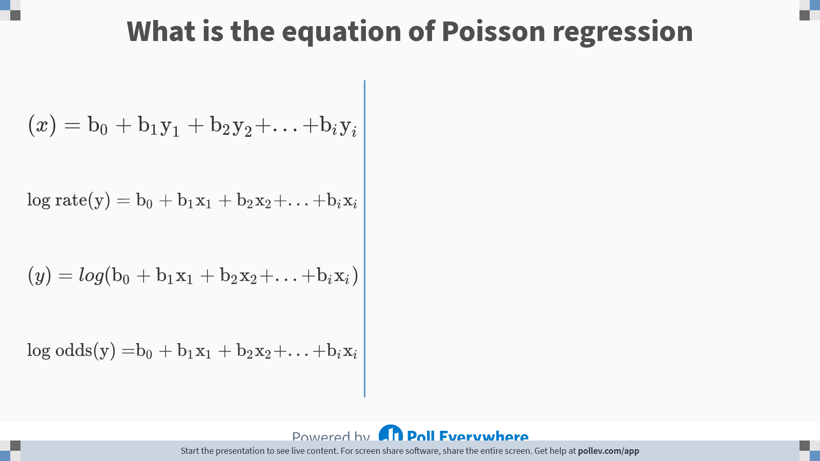
Notes:
Poll Title: Do not modify the notes in this section to avoid tampering with the Poll Everywhere activity. More info at polleverywhere.com/support What is the equation of Poisson regression https://www.polleverywhere.com/multiple_choice_polls/LireSuaDCX8cMy7FoOuOp?display_state=chart&activity_state=closed&state=closed&flow=Instructor&onscreen=persist

Slide 34
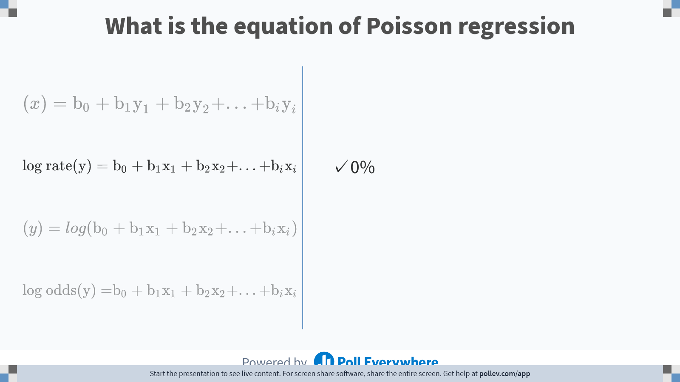
Notes:
Poll Title: Do not modify the notes in this section to avoid tampering with the Poll Everywhere activity. More info at polleverywhere.com/support What is the equation of Poisson regression https://www.polleverywhere.com/multiple_choice_polls/LireSuaDCX8cMy7FoOuOp?display_state=chart&activity_state=closed&display=correctness&state=closed&flow=Instructor&onscreen=persist

Slide 35
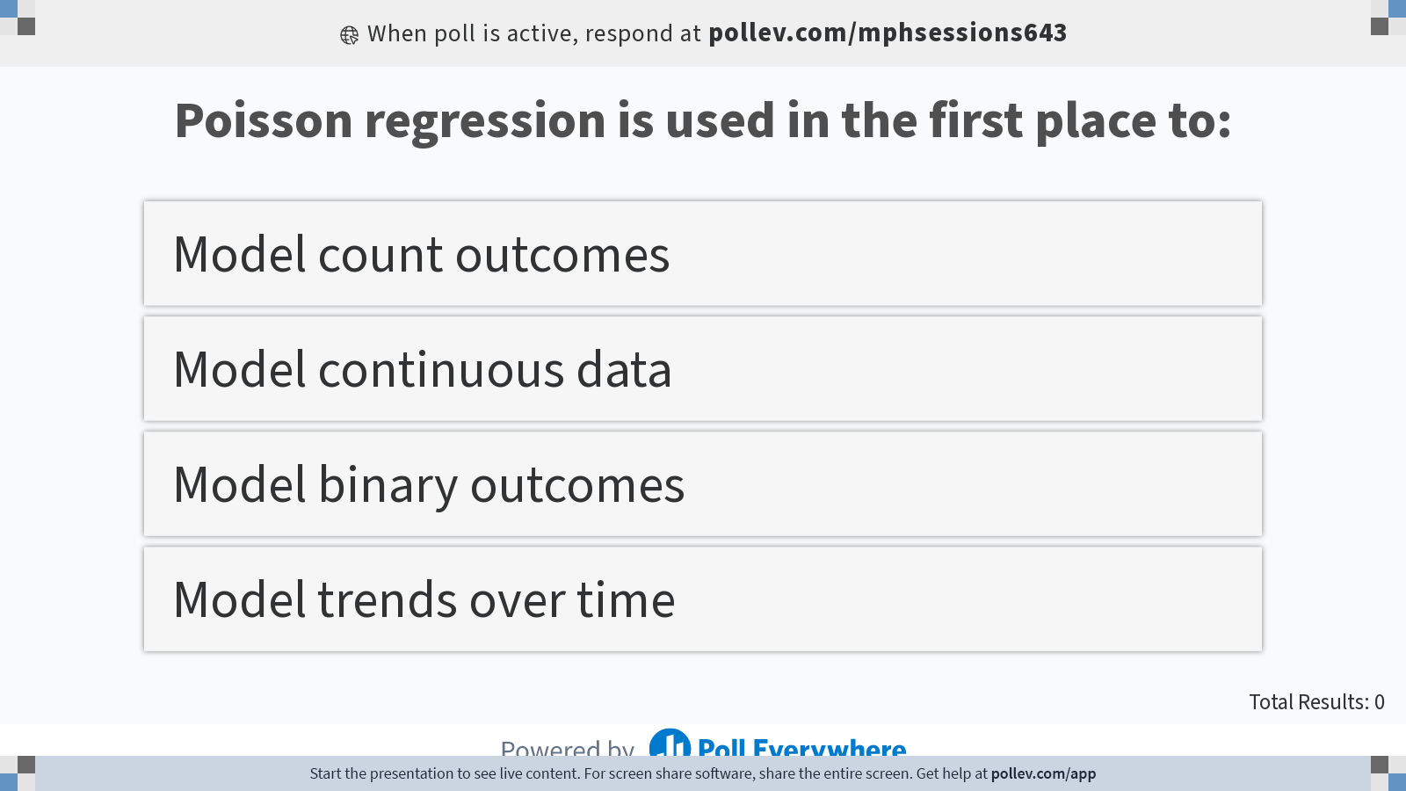
Notes:
Poll Title: Do not modify the notes in this section to avoid tampering with the Poll Everywhere activity. More info at polleverywhere.com/support Poisson regression is used in the first place to: https://www.polleverywhere.com/multiple_choice_polls/yDWnhBWoY99NoXq7cgKyy?display_state=instructions&activity_state=opened&state=opened&flow=Instructor&onscreen=persist

Slide 36
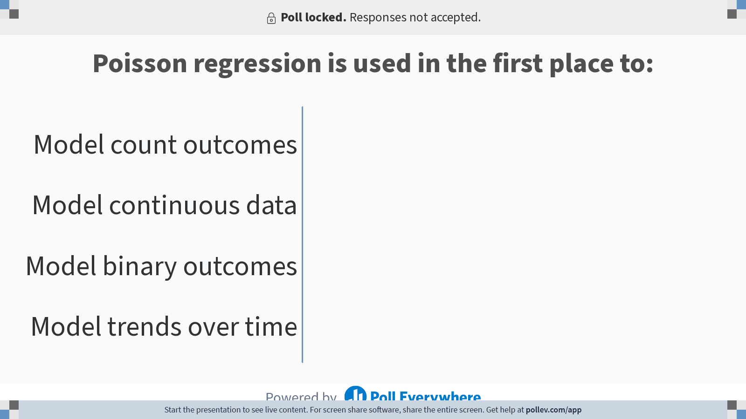
Notes:
Poll Title: Do not modify the notes in this section to avoid tampering with the Poll Everywhere activity. More info at polleverywhere.com/support Poisson regression is used in the first place to: https://www.polleverywhere.com/multiple_choice_polls/yDWnhBWoY99NoXq7cgKyy?display_state=chart&activity_state=closed&state=closed&flow=Instructor&onscreen=persist

Slide 37
Notes:
Poll Title: Do not modify the notes in this section to avoid tampering with the Poll Everywhere activity. More info at polleverywhere.com/support Poisson regression is used in the first place to: https://www.polleverywhere.com/multiple_choice_polls/yDWnhBWoY99NoXq7cgKyy?display_state=chart&activity_state=closed&display=correctness&state=closed&flow=Instructor&onscreen=persist

Slide 38
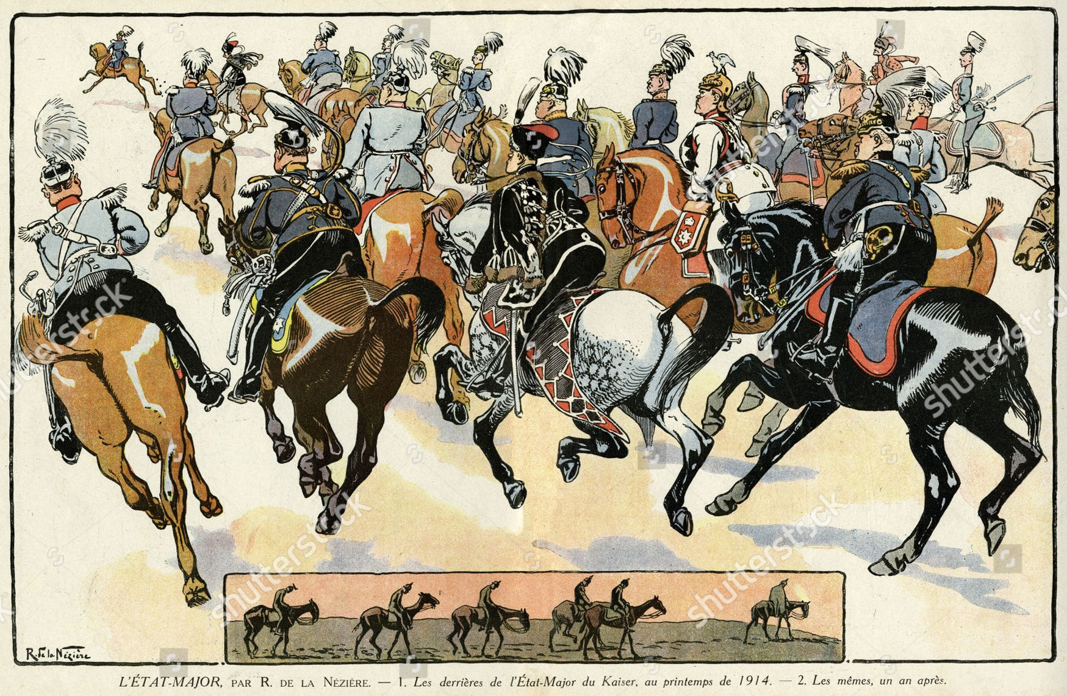
In the 19th century, the Prussian army were a formidable fighting force. Unfortunately, their horses were at times bad tempered and some of their soldiers perished not in battle but as result of being kicked by a horse. Fortunately, they did have a statistician who kept detailed records for the period of 1875-1894. In the following questions we will explore those data set.

Slide 39
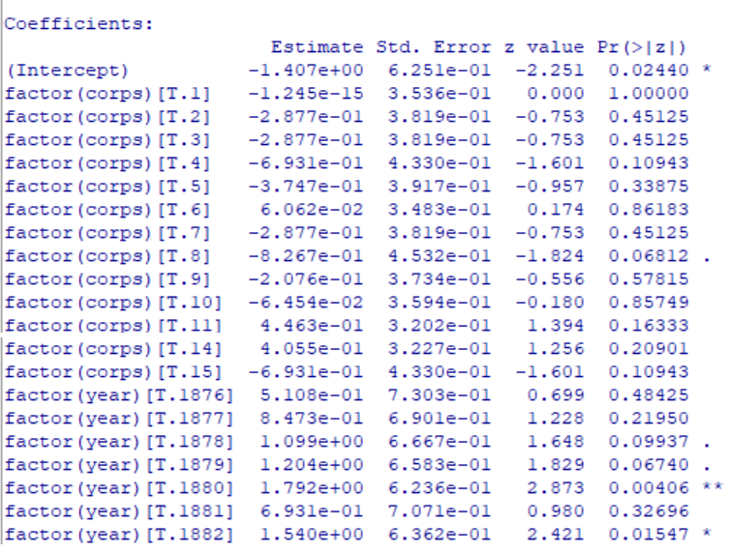
The Prussian army statistician fitted this poisson model: GLM.1 <- glm(deaths ~ factor(corps) + factor(year ), family=poisson(log), data=horse_kick) Below you see part of the output.

Slide 40
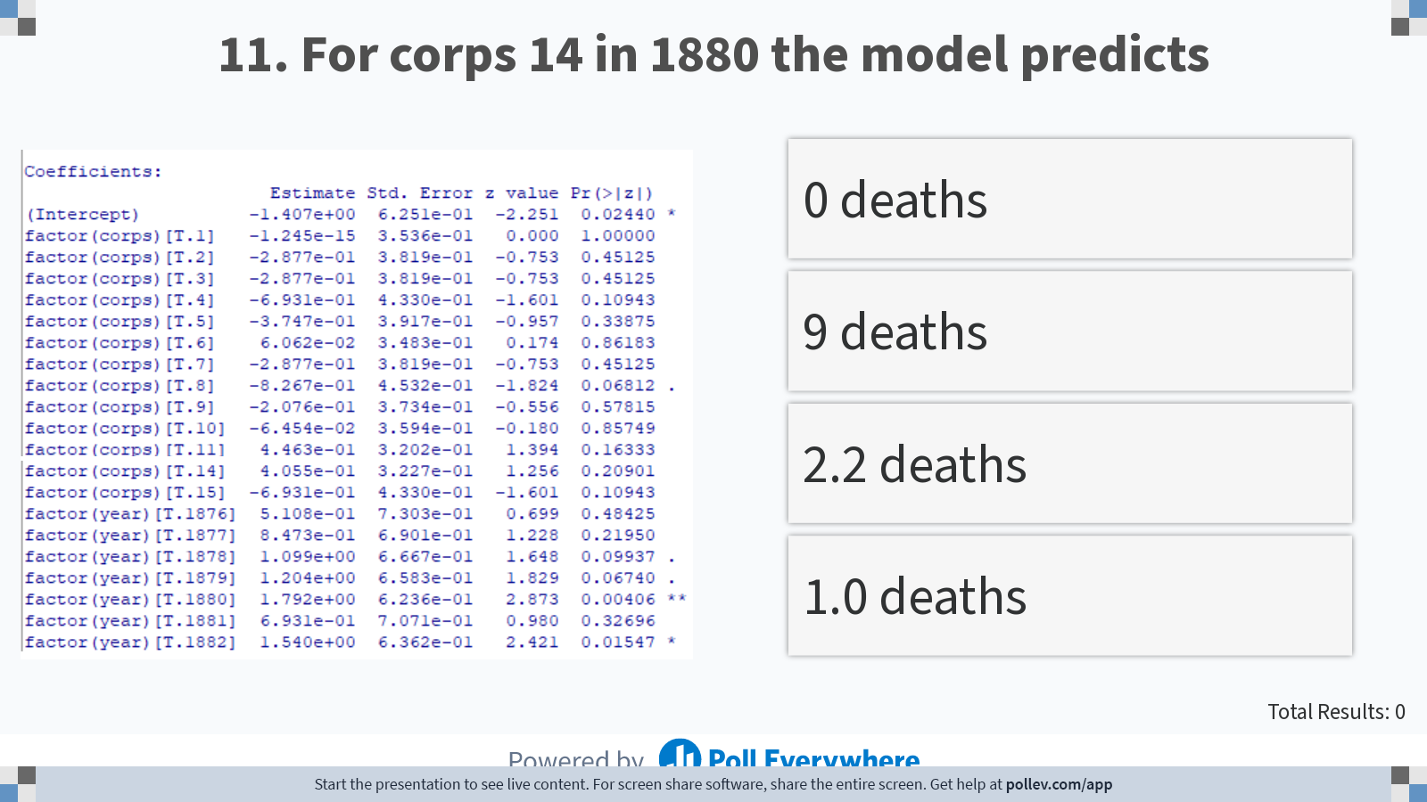
Notes:
Poll Title: Do not modify the notes in this section to avoid tampering with the Poll Everywhere activity. More info at polleverywhere.com/support For corps 14 in 1880 the model predicts https://www.polleverywhere.com/multiple_choice_polls/9AEqP9htdIaSsnnfVKv9a?display_state=instructions&activity_state=opened&state=opened&flow=Engagement&onscreen=persist

Slide 41
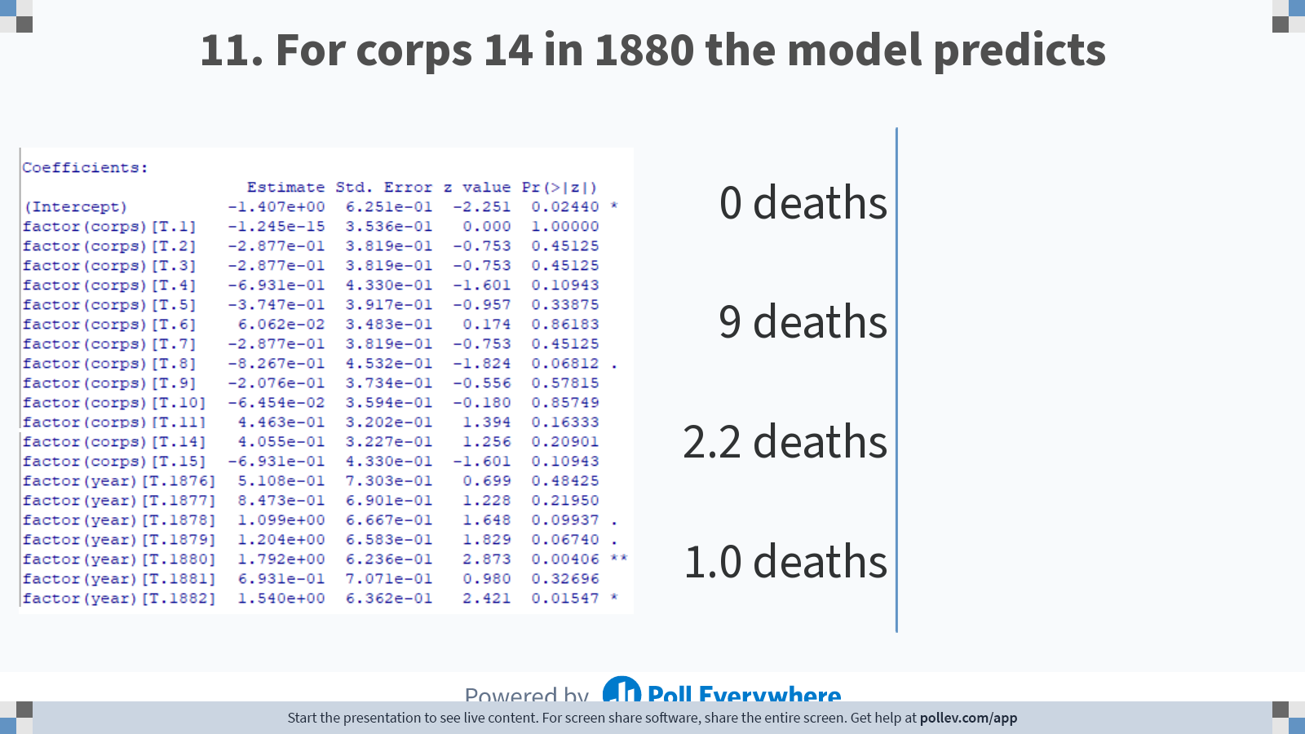
Notes:
Poll Title: Do not modify the notes in this section to avoid tampering with the Poll Everywhere activity. More info at polleverywhere.com/support For corps 14 in 1880 the model predicts https://www.polleverywhere.com/multiple_choice_polls/9AEqP9htdIaSsnnfVKv9a?display_state=chart&activity_state=opened&state=opened&flow=Engagement&onscreen=persist

Slide 42
Notes:
Poll Title: Do not modify the notes in this section to avoid tampering with the Poll Everywhere activity. More info at polleverywhere.com/support For corps 14 in 1880 the model predicts https://www.polleverywhere.com/multiple_choice_polls/9AEqP9htdIaSsnnfVKv9a?display_state=chart&activity_state=closed&state=closed&flow=Engagement&onscreen=persist

Slide 43
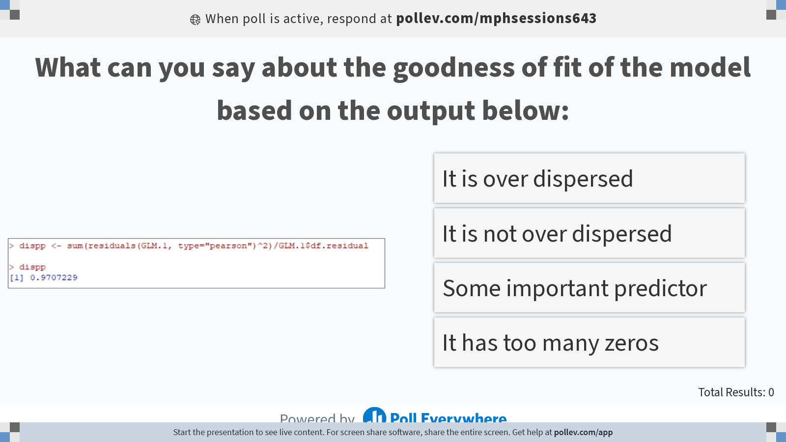
Notes:
Poll Title: Do not modify the notes in this section to avoid tampering with the Poll Everywhere activity. More info at polleverywhere.com/support What can you say about the goodness of fit of the model based on the output below: https://www.polleverywhere.com/multiple_choice_polls/cCIHpmUfaPW6Y8SxwpNv1?display_state=instructions&activity_state=opened&state=opened&flow=Instructor&onscreen=persist

Slide 44
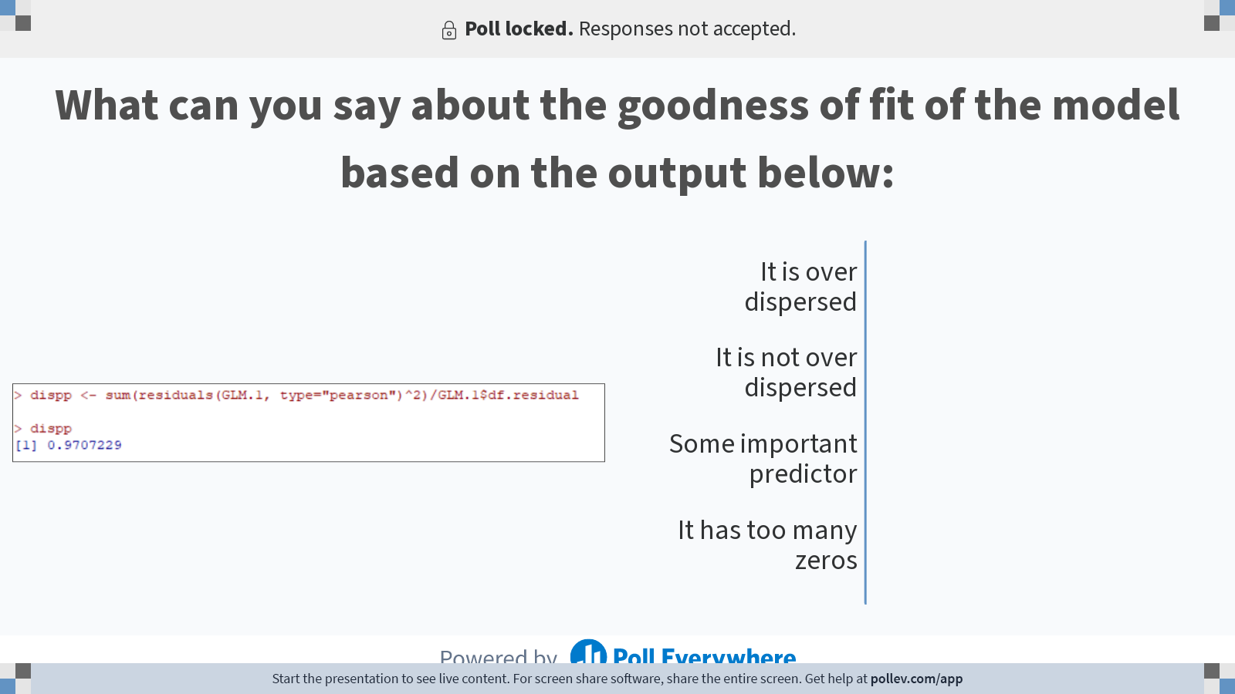
Notes:
Poll Title: Do not modify the notes in this section to avoid tampering with the Poll Everywhere activity. More info at polleverywhere.com/support What can you say about the goodness of fit of the model based on the output below: https://www.polleverywhere.com/multiple_choice_polls/cCIHpmUfaPW6Y8SxwpNv1?display_state=chart&activity_state=closed&state=closed&flow=Instructor&onscreen=persist

Slide 45
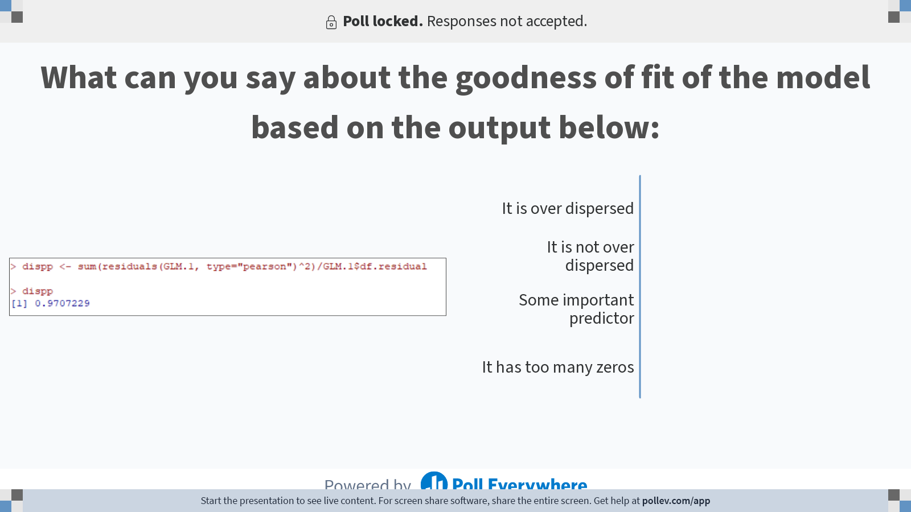
Notes:
Poll Title: Do not modify the notes in this section to avoid tampering with the Poll Everywhere activity. More info at polleverywhere.com/support What can you say about the goodness of fit of the model based on the output below: https://www.polleverywhere.com/multiple_choice_polls/cCIHpmUfaPW6Y8SxwpNv1?display_state=chart&activity_state=closed&display=correctness&state=closed&flow=Instructor&onscreen=persist

Slide 46
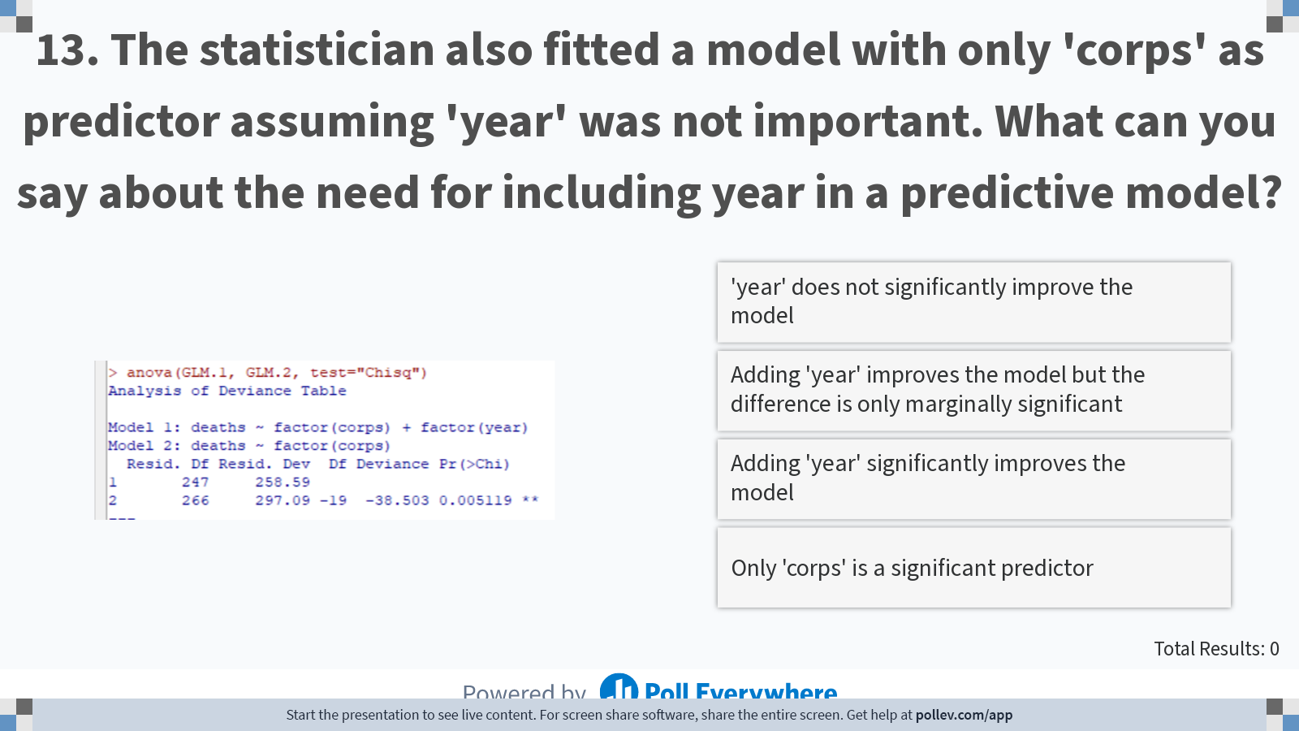
Notes:
Poll Title: Do not modify the notes in this section to avoid tampering with the Poll Everywhere activity. More info at polleverywhere.com/support The statistician also fitted a model with only 'corps' as predictor assuming 'year' was not important. What can you say about the need for including year in a predictive model? https://www.polleverywhere.com/multiple_choice_polls/Y3jf6TpesbMYT45CqE3Uo?display_state=instructions&activity_state=opened&state=opened&flow=Instructor&onscreen=persist

Slide 47
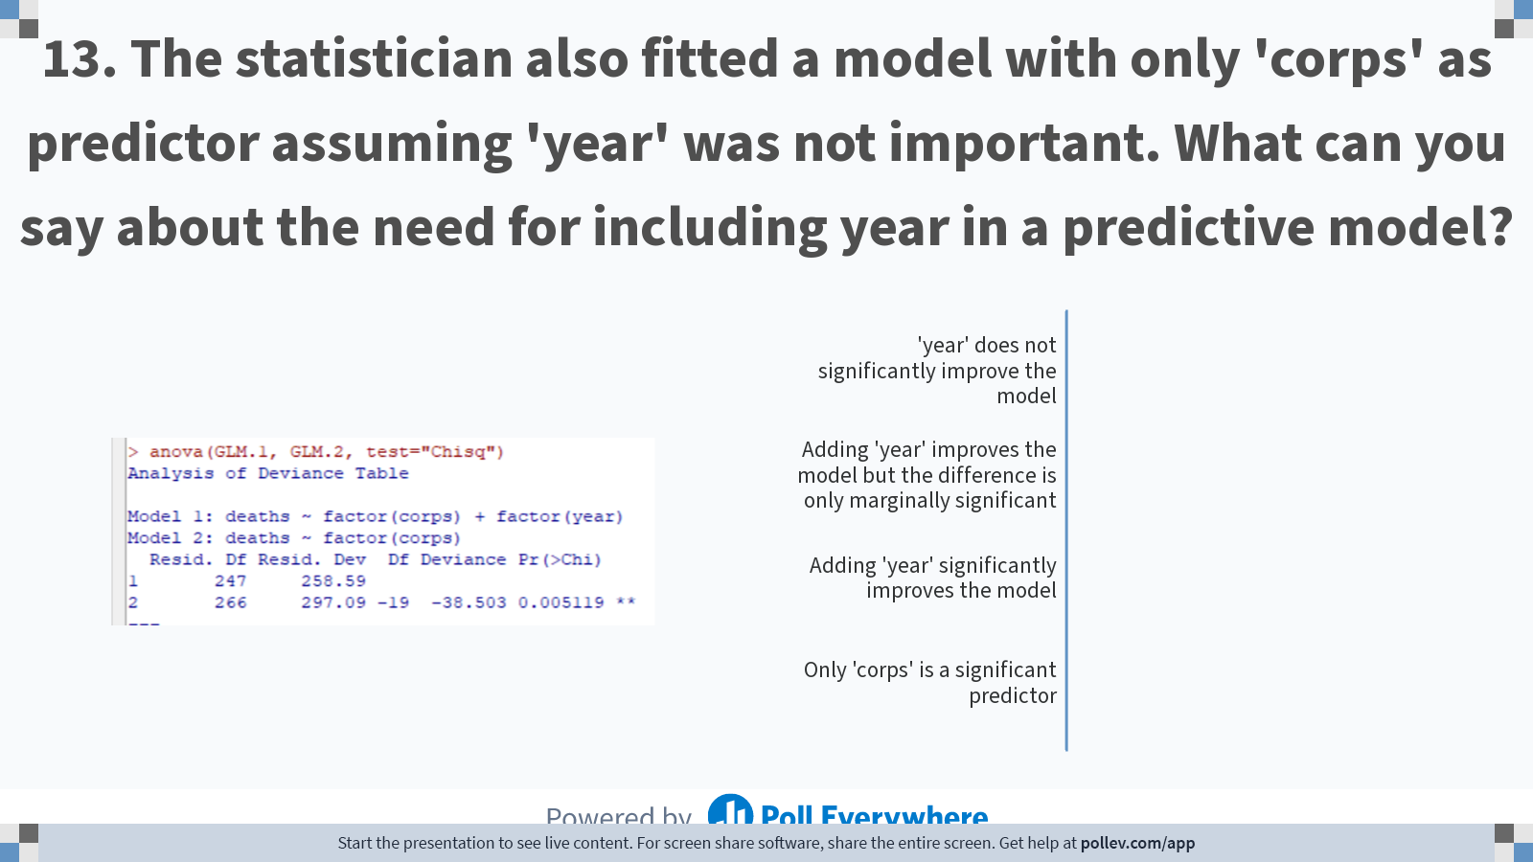
Notes:
Poll Title: Do not modify the notes in this section to avoid tampering with the Poll Everywhere activity. More info at polleverywhere.com/support The statistician also fitted a model with only 'corps' as predictor assuming 'year' was not important. What can you say about the need for including year in a predictive model? https://www.polleverywhere.com/multiple_choice_polls/Y3jf6TpesbMYT45CqE3Uo?display_state=chart&activity_state=closed&state=closed&flow=Instructor&onscreen=persist

Slide 48
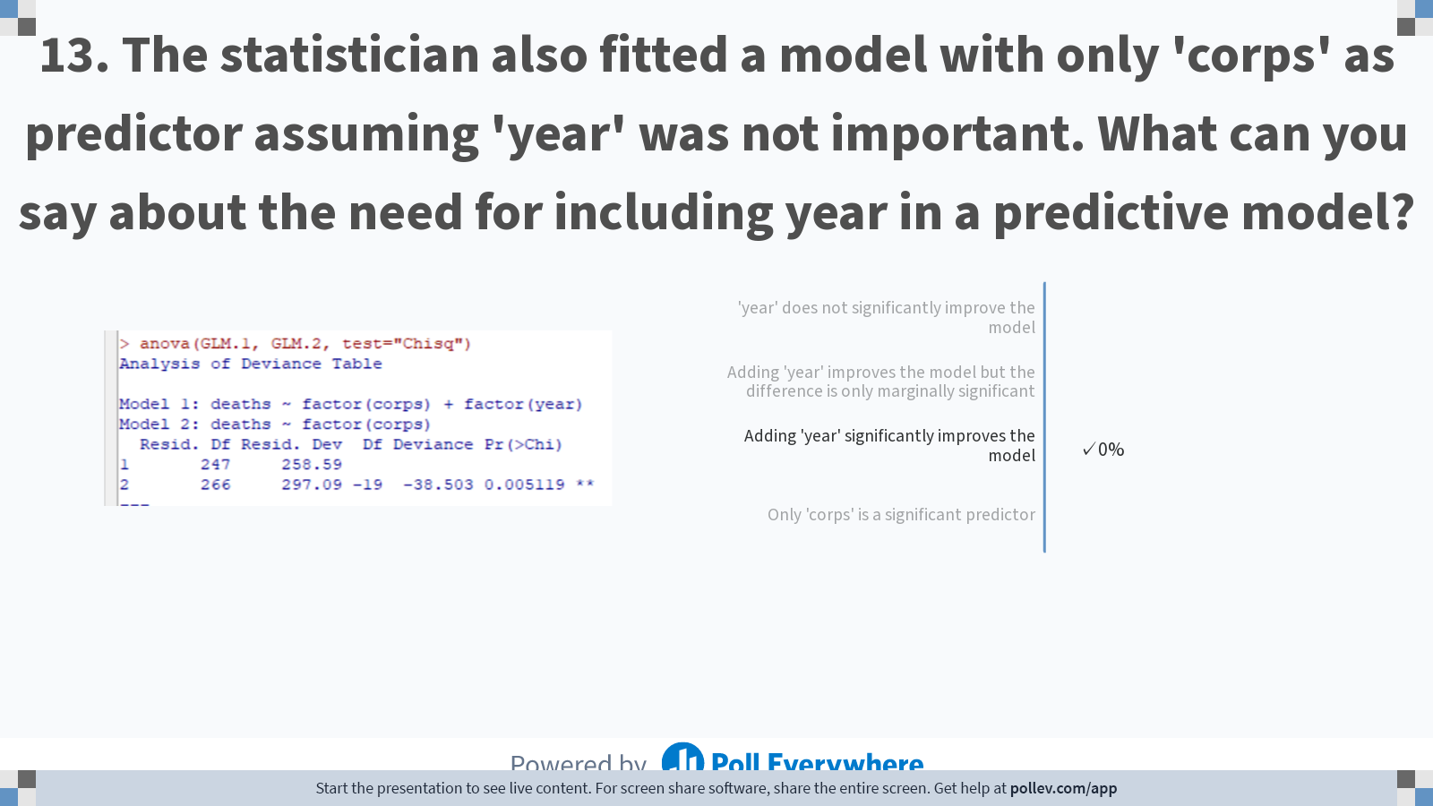
Notes:
Poll Title: Do not modify the notes in this section to avoid tampering with the Poll Everywhere activity. More info at polleverywhere.com/support The statistician also fitted a model with only 'corps' as predictor assuming 'year' was not important. What can you say about the need for including year in a predictive model? https://www.polleverywhere.com/multiple_choice_polls/Y3jf6TpesbMYT45CqE3Uo?display_state=chart&activity_state=closed&display=correctness&state=closed&flow=Instructor&onscreen=persist

Slide 49
Notes:
Poll Title: Do not modify the notes in this section to avoid tampering with the Poll Everywhere activity. More info at polleverywhere.com/support 13. The statistician also fitted a model with only 'corps' as predictor assuming 'year' was not important. What can you say about the need for including year in a predictive model? https://www.polleverywhere.com/multiple_choice_polls/Y3jf6TpesbMYT45CqE3Uo

Slide 50
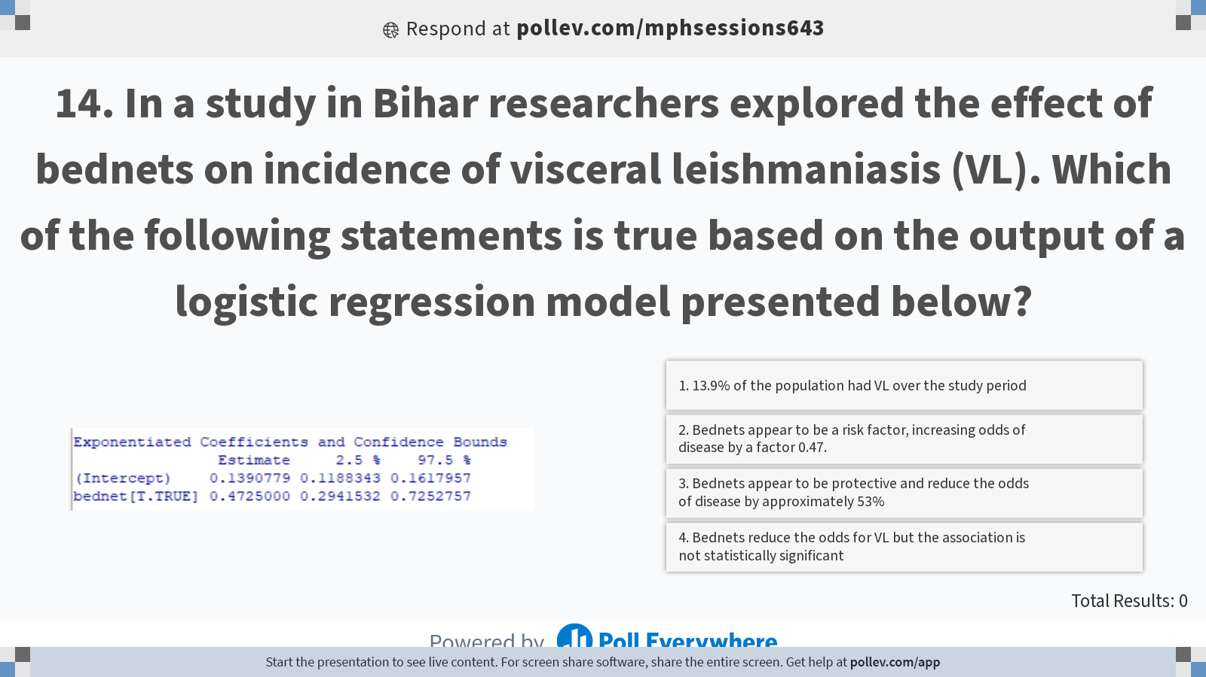
Notes:
Poll Title: Do not modify the notes in this section to avoid tampering with the Poll Everywhere activity. More info at polleverywhere.com/support 14. In a study in Bihar researchers explored the effect of bednets on incidence of visceral leishmaniasis (VL). Which of the following statements is true based on the output of a logistic regression model presented below? https://www.polleverywhere.com/multiple_choice_polls/y60s4IjdQ8k8dXTQIWGiG?display_state=instructions&activity_state=opened&state=opened&flow=Engagement&onscreen=persist

Slide 51
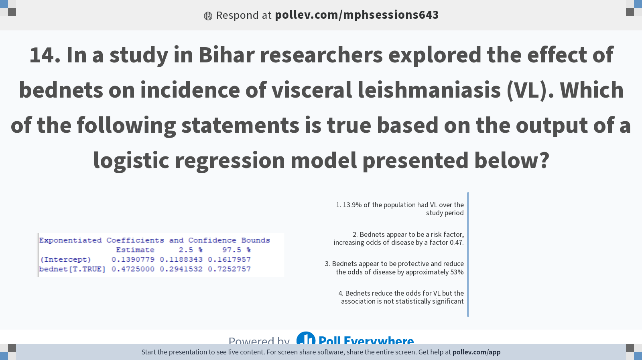
Notes:
Poll Title: Do not modify the notes in this section to avoid tampering with the Poll Everywhere activity. More info at polleverywhere.com/support 14. In a study in Bihar researchers explored the effect of bednets on incidence of visceral leishmaniasis (VL). Which of the following statements is true based on the output of a logistic regression model presented below? https://www.polleverywhere.com/multiple_choice_polls/y60s4IjdQ8k8dXTQIWGiG?display_state=chart&activity_state=opened&state=opened&flow=Engagement&onscreen=persist

Slide 52
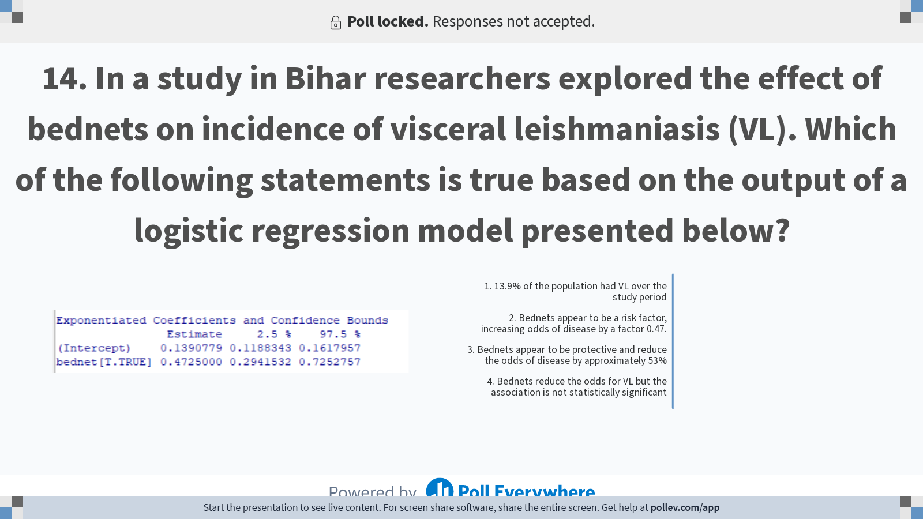
Notes:
Poll Title: Do not modify the notes in this section to avoid tampering with the Poll Everywhere activity. More info at polleverywhere.com/support 14. In a study in Bihar researchers explored the effect of bednets on incidence of visceral leishmaniasis (VL). Which of the following statements is true based on the output of a logistic regression model presented below? https://www.polleverywhere.com/multiple_choice_polls/y60s4IjdQ8k8dXTQIWGiG?display_state=chart&activity_state=closed&state=closed&flow=Engagement&onscreen=persist

Slide 53
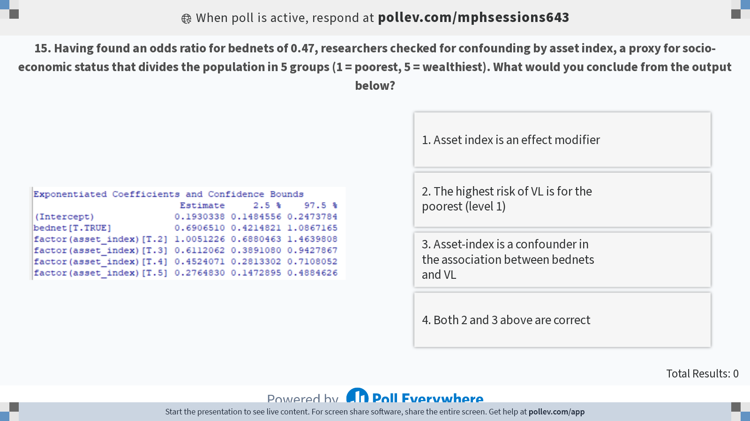
Notes:
Poll Title: Do not modify the notes in this section to avoid tampering with the Poll Everywhere activity. More info at polleverywhere.com/support 15. Having found an odds ratio for bednets of 0.47, researchers checked for confounding by asset index, a proxy for socio-economic status that divides the population in 5 groups (1 = poorest, 5 = wealthiest). What would you conclude from the output below? https://www.polleverywhere.com/multiple_choice_polls/Q0Qc0IZMu1WDkWKSHvZE5?display_state=instructions&activity_state=opened&state=opened&flow=Engagement&onscreen=persist

Slide 54
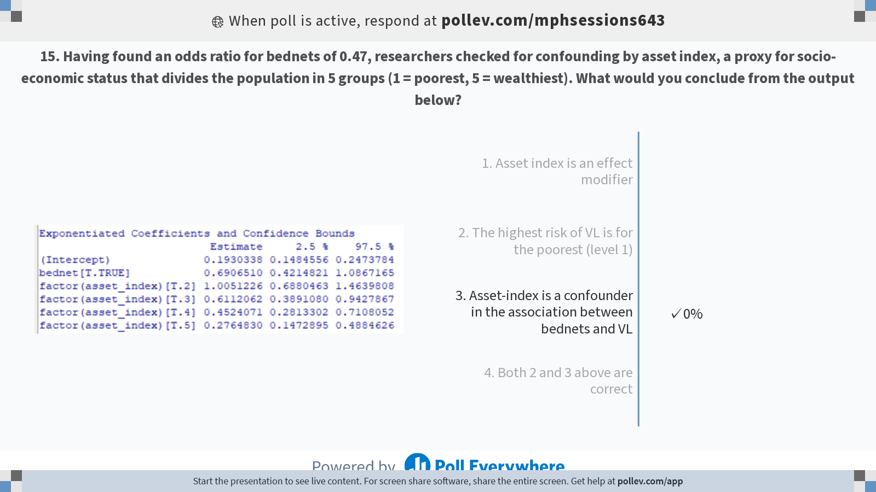
Notes:
Poll Title: Do not modify the notes in this section to avoid tampering with the Poll Everywhere activity. More info at polleverywhere.com/support 15. Having found an odds ratio for bednets of 0.47, researchers checked for confounding by asset index, a proxy for socio-economic status that divides the population in 5 groups (1 = poorest, 5 = wealthiest). What would you conclude from the output below? https://www.polleverywhere.com/multiple_choice_polls/Q0Qc0IZMu1WDkWKSHvZE5?display_state=chart&activity_state=opened&state=opened&flow=Engagement&onscreen=persist

Slide 55

Notes:
Poll Title: Do not modify the notes in this section to avoid tampering with the Poll Everywhere activity. More info at polleverywhere.com/support 15. Having found an odds ratio for bednets of 0.47, researchers checked for confounding by asset index, a proxy for socio-economic status that divides the population in 5 groups (1 = poorest, 5 = wealthiest). What would you conclude from the output below? https://www.polleverywhere.com/multiple_choice_polls/Q0Qc0IZMu1WDkWKSHvZE5?display_state=chart&activity_state=closed&state=closed&flow=Engagement&onscreen=persist

Slide 56

Notes:
Poll Title: Do not modify the notes in this section to avoid tampering with the Poll Everywhere activity. More info at polleverywhere.com/support 16. Based on the output below, would you expect that the effect of bednet is different in different classes of asset index? https://www.polleverywhere.com/multiple_choice_polls/MSWbXIZVUqq9EujLjdq54?display_state=instructions&activity_state=opened&state=opened&flow=Instructor&onscreen=persist

Slide 57

Notes:
Poll Title: Do not modify the notes in this section to avoid tampering with the Poll Everywhere activity. More info at polleverywhere.com/support 16. Based on the output below, would you expect that the effect of bednet is different in different classes of asset index? https://www.polleverywhere.com/multiple_choice_polls/MSWbXIZVUqq9EujLjdq54?display_state=chart&activity_state=closed&state=closed&flow=Instructor&onscreen=persist

Slide 58

Notes:
Poll Title: Do not modify the notes in this section to avoid tampering with the Poll Everywhere activity. More info at polleverywhere.com/support 16. Based on the output below, would you expect that the effect of bednet is different in different classes of asset index? https://www.polleverywhere.com/multiple_choice_polls/MSWbXIZVUqq9EujLjdq54?display_state=chart&activity_state=closed&display=correctness&state=closed&flow=Instructor&onscreen=persist

Slide 59

Notes:
Poll Title: Do not modify the notes in this section to avoid tampering with the Poll Everywhere activity. More info at polleverywhere.com/support 17. What would you conclude on the association between bednets and VL based on the table below with results of a study of Bern et al. ? https://www.polleverywhere.com/multiple_choice_polls/Jxg8mlvHOjPsNDTGQzpUG?display_state=instructions&activity_state=opened&state=opened&flow=Instructor&onscreen=persist

Slide 60

Notes:
Poll Title: Do not modify the notes in this section to avoid tampering with the Poll Everywhere activity. More info at polleverywhere.com/support 17. What would you conclude on the association between bednets and VL based on the table below with results of a study of Bern et al. ? https://www.polleverywhere.com/multiple_choice_polls/Jxg8mlvHOjPsNDTGQzpUG?display_state=chart&activity_state=closed&state=closed&flow=Instructor&onscreen=persist

Slide 61
Notes:
Poll Title: Do not modify the notes in this section to avoid tampering with the Poll Everywhere activity. More info at polleverywhere.com/support 17. What would you conclude on the association between bednets and VL based on the table below with results of a study of Bern et al. ? https://www.polleverywhere.com/multiple_choice_polls/Jxg8mlvHOjPsNDTGQzpUG?display_state=chart&activity_state=closed&display=correctness&state=closed&flow=Instructor&onscreen=persist

Slide 62

Notes:
Poll Title: Do not modify the notes in this section to avoid tampering with the Poll Everywhere activity. More info at polleverywhere.com/support 18. The table below is from a study by Zoller et al. who explored risk factors for East African sleeping sickness, a vector borne disease transmitted by tsetse flies with animals as main reservoir. What could we conclude based on the results shown? https://www.polleverywhere.com/multiple_choice_polls/L8T6ZNLbxN4dDxCBP91iD?display_state=instructions&activity_state=opened&state=opened&flow=Engagement&onscreen=persist

Slide 63

Notes:
Poll Title: Do not modify the notes in this section to avoid tampering with the Poll Everywhere activity. More info at polleverywhere.com/support 18. The table below is from a study by Zoller et al. who explored risk factors for East African sleeping sickness, a vector borne disease transmitted by tsetse flies with animals as main reservoir. What could we conclude based on the results shown? https://www.polleverywhere.com/multiple_choice_polls/L8T6ZNLbxN4dDxCBP91iD?display_state=chart&activity_state=opened&state=opened&flow=Engagement&onscreen=persist

Slide 64
Notes:
Poll Title: Do not modify the notes in this section to avoid tampering with the Poll Everywhere activity. More info at polleverywhere.com/support 18. The table below is from a study by Zoller et al. who explored risk factors for East African sleeping sickness, a vector borne disease transmitted by tsetse flies with animals as main reservoir. What could we conclude based on the results shown? https://www.polleverywhere.com/multiple_choice_polls/L8T6ZNLbxN4dDxCBP91iD?display_state=chart&activity_state=closed&state=closed&flow=Engagement&onscreen=persist

Slide 65

Notes:
Poll Title: Do not modify the notes in this section to avoid tampering with the Poll Everywhere activity. More info at polleverywhere.com/support 19. The table is from the same study. Having banana trees around the house was strongly protective in the final model shown in the previous question (OR = 0.2, p=0.017) but less so on univariate analysis (OR = 0.47, p=0.079). What could be the reason? https://www.polleverywhere.com/multiple_choice_polls/A6gAnfBAenc48Noa600sb?display_state=instructions&activity_state=opened&state=opened&flow=Engagement&onscreen=persist

Slide 66

Notes:
Poll Title: Do not modify the notes in this section to avoid tampering with the Poll Everywhere activity. More info at polleverywhere.com/support 19. The table is from the same study. Having banana trees around the house was strongly protective in the final model shown in the previous question (OR = 0.2, p=0.017) but less so on univariate analysis (OR = 0.47, p=0.079). What could be the reason? https://www.polleverywhere.com/multiple_choice_polls/A6gAnfBAenc48Noa600sb?display_state=chart&activity_state=opened&state=opened&flow=Engagement&onscreen=persist

Slide 67

Notes:
Poll Title: Do not modify the notes in this section to avoid tampering with the Poll Everywhere activity. More info at polleverywhere.com/support 19. The table is from the same study. Having banana trees around the house was strongly protective in the final model shown in the previous question (OR = 0.2, p=0.017) but less so on univariate analysis (OR = 0.47, p=0.079). What could be the reason? https://www.polleverywhere.com/multiple_choice_polls/A6gAnfBAenc48Noa600sb?display_state=chart&activity_state=closed&state=closed&flow=Engagement&onscreen=persist

Slide 68

Notes:
Poll Title: Do not modify the notes in this section to avoid tampering with the Poll Everywhere activity. More info at polleverywhere.com/support 20. The output below shows the results of a logistic regression model on the association between education (1 = some, 0 = none) and contraception use (1 = yes, 0 = no) among 1607 women of fertile age. Which of the statements is true? https://www.polleverywhere.com/multiple_choice_polls/kpPbUXnCT6KpkJaopNNWF?display_state=instructions&activity_state=opened&state=opened&flow=Instructor&onscreen=persist

Slide 69

Notes:
Poll Title: Do not modify the notes in this section to avoid tampering with the Poll Everywhere activity. More info at polleverywhere.com/support 20. The output below shows the results of a logistic regression model on the association between education (1 = some, 0 = none) and contraception use (1 = yes, 0 = no) among 1607 women of fertile age. Which of the statements is true? https://www.polleverywhere.com/multiple_choice_polls/kpPbUXnCT6KpkJaopNNWF?display_state=chart&activity_state=closed&state=closed&flow=Instructor&onscreen=persist

Slide 70

Notes:
Poll Title: Do not modify the notes in this section to avoid tampering with the Poll Everywhere activity. More info at polleverywhere.com/support 20. The output below shows the results of a logistic regression model on the association between education (1 = some, 0 = none) and contraception use (1 = yes, 0 = no) among 1607 women of fertile age. Which of the statements is true? https://www.polleverywhere.com/multiple_choice_polls/kpPbUXnCT6KpkJaopNNWF?display_state=chart&activity_state=closed&display=correctness&state=closed&flow=Instructor&onscreen=persist

